Slide 1
2024 GOA Pcod assessment
September 2024 Plan Team

Slide 2
Background
Vision for this year was to clean/redevelop input data scripts to then work on modelling analyses
As you’ll soon see, redevelopment of data scripts hit some bumps that required a bit of attention – took much longer than anticipated
Data code redeveloped, streamlined, and documented
A number of redundancies and dead ends removed
Resulted in reduction of the number of lines of code and ~30% reduction in run time (8 min vs 12 min)

Slide 3
Outline
Data updates/recommended base changes to model input files
Additional recommended data changes: Update ageing error, fishery length comps, length comp binning
Evaluated apportionment changes: inclusion of AFSC longline survey
Evaluated model changes: survey/fishery selex, ISS
Upcoming assessment work
Forgiveness & permission…

Slide 4
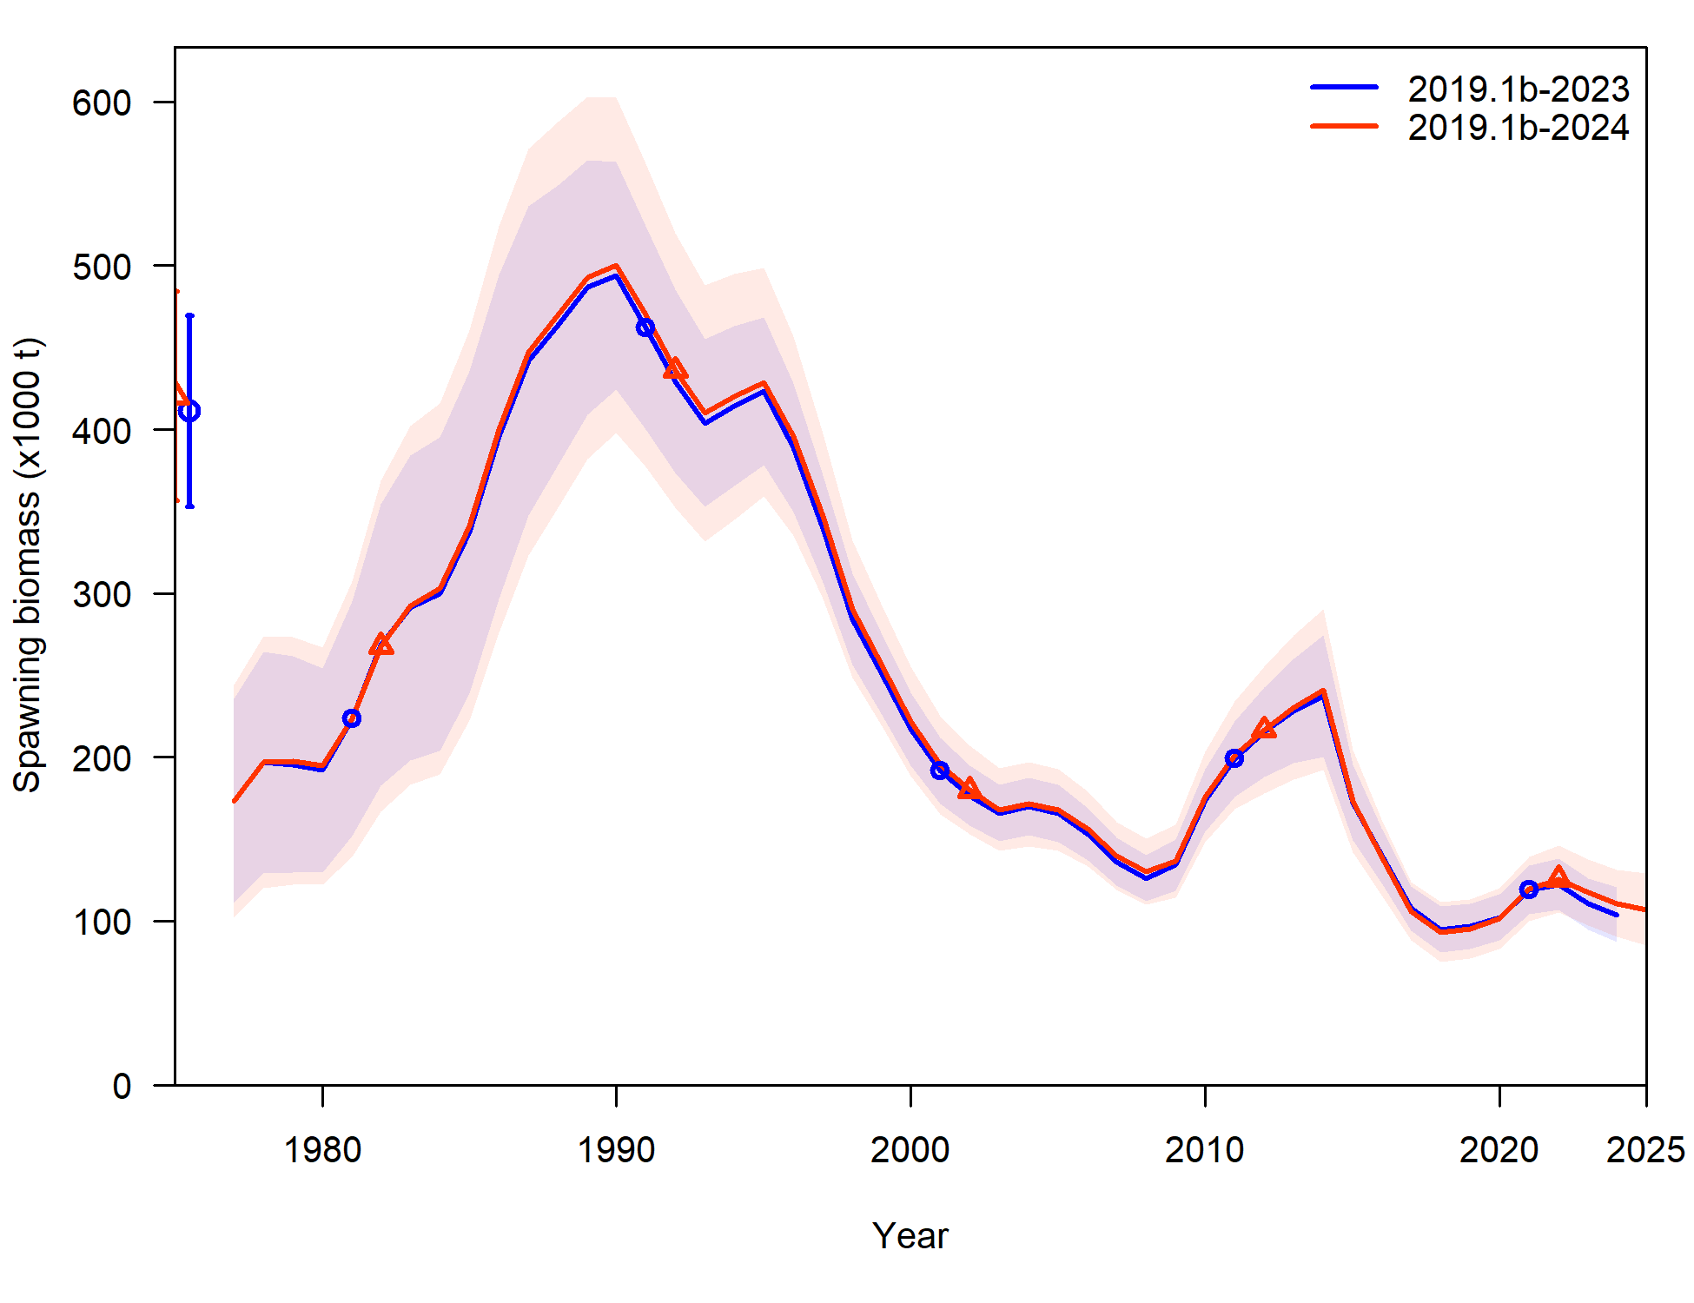
Base data updates (2019.1b-2024)
Noteworthy difference: Trawl survey
GAP cleaned up old haul data, only includes specimen data associated with a haul that is used to compute abundance
Resulted in minor differences in early trawl survey time series for abundance and comp data
Updating fishery data update results in slight uptick in spawning biomass at end of time-series compared to 2023 assessment

Slide 5
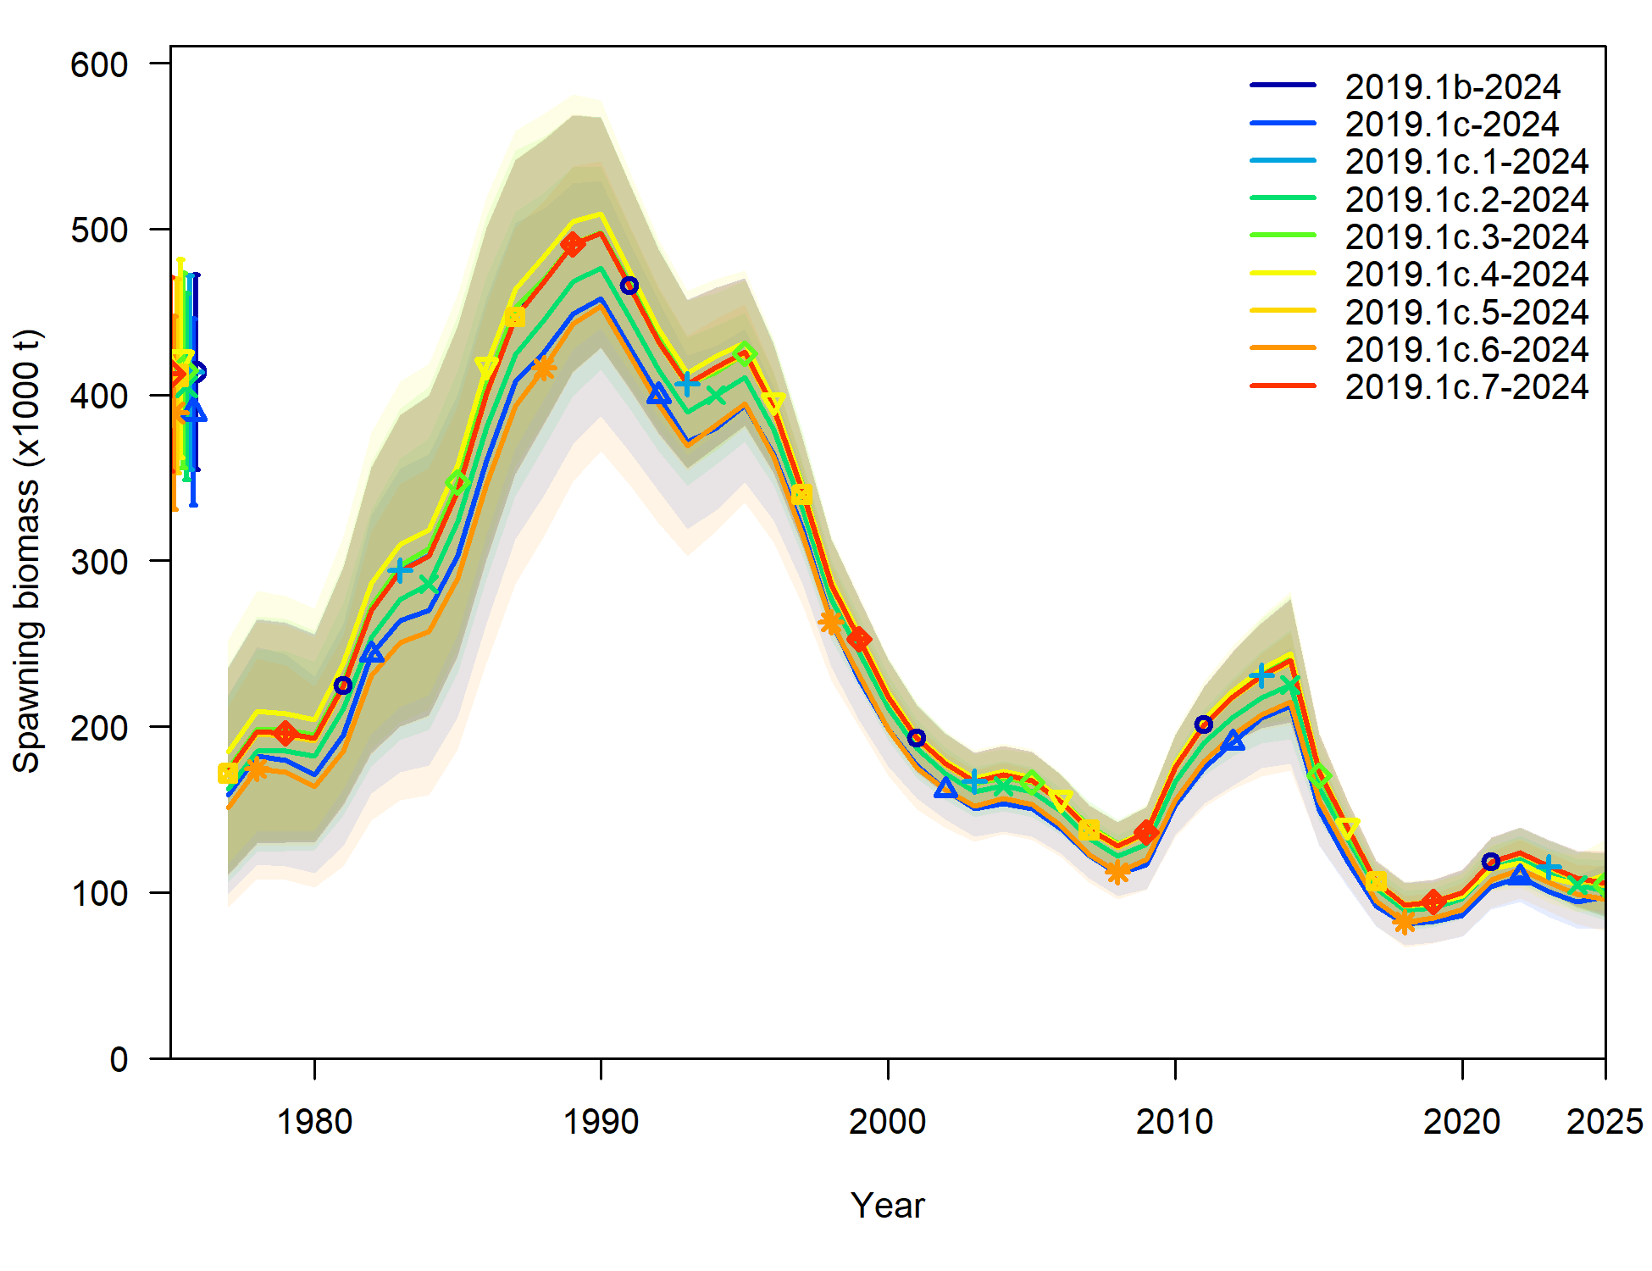
Input data file changes
7 changes recommended: denoted as 2019.1c.#
All added 1 at a time to model 2019.1b to evaluate sensitivity of model to each change individually

Slide 6
Input data file changes
LL survey:
Log-normal computation for RPN SD hadn’t been applied (but was applied to bottom trawl survey index), now is applied – 2019.1c.1
Length comps off by a cm (i.e., 25 cm fish became 26 cm) – 2019.1c.2
Length comps season had been set at 1 (Jan), when should have been set at 7 (Jul) – 2019.1c.3
Fishery length comps:
ISS set at total number of hauls sampled (max 200), but filtered hauls to a certain sample size in expansion, set at number of hauls actually used in expansion (max 200) – 2019.1c.4

Slide 7
Input data file changes
All length comps:
Set plus bin at 104 cm rather than 116 cm (<2% of years ꓯ data >0.01) – 2019.1c.5
Trawl survey conditional age-at-length
Season had been set at 1 (Jan), when should have been set at 7 (Jul) – 2019.1c.6
Consistency across assessments:
Turn off forecast recruitment parameters – 2019.1c.7

Slide 8
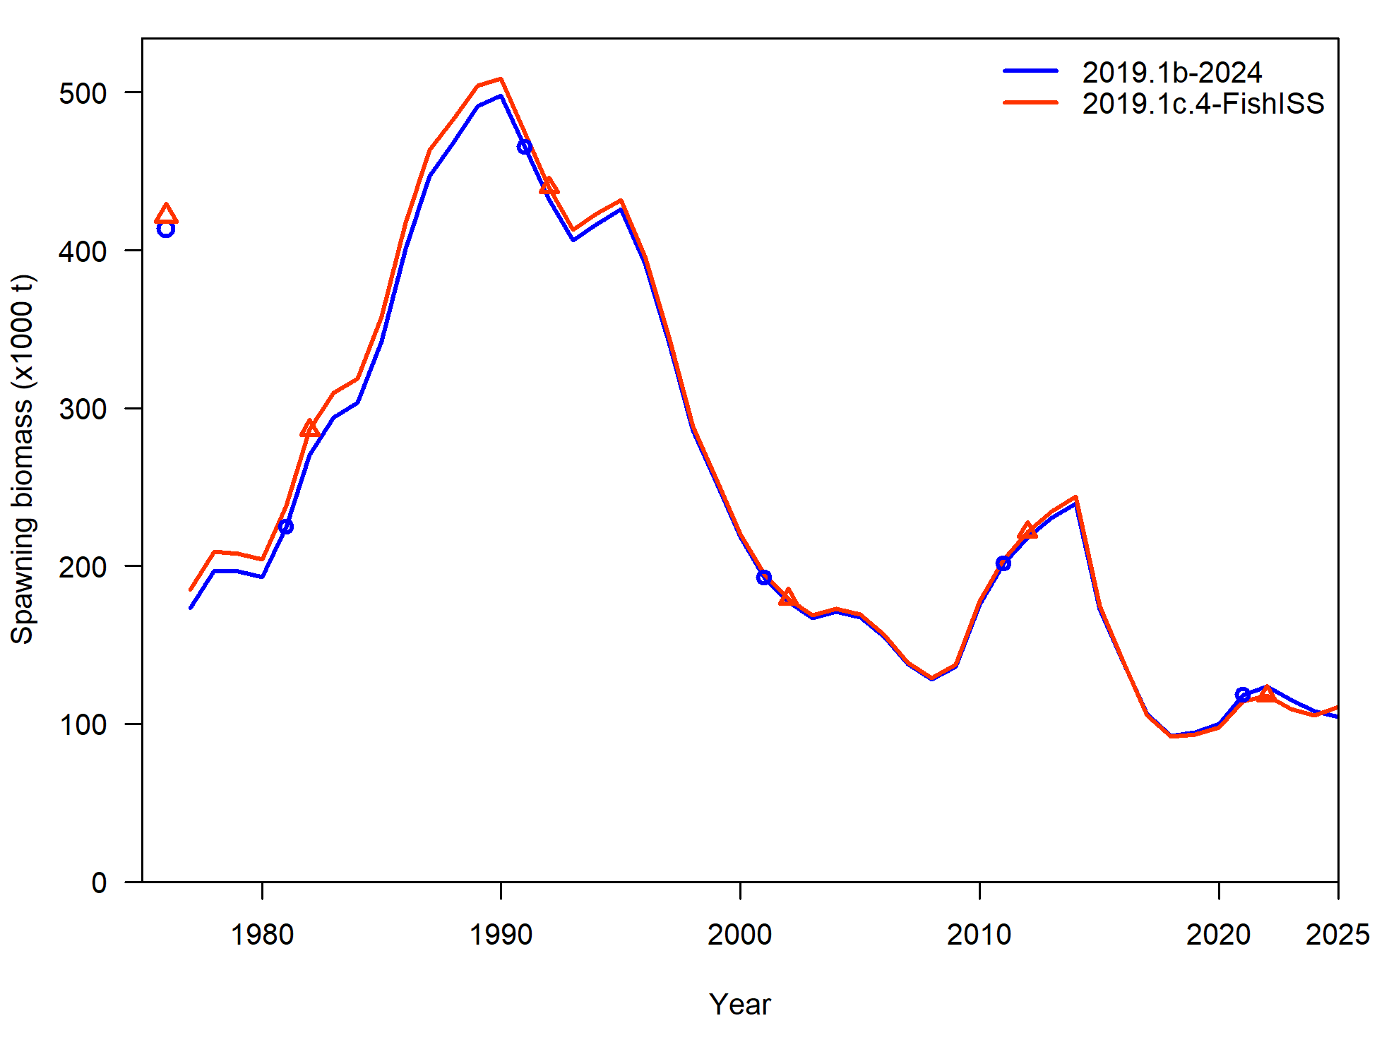
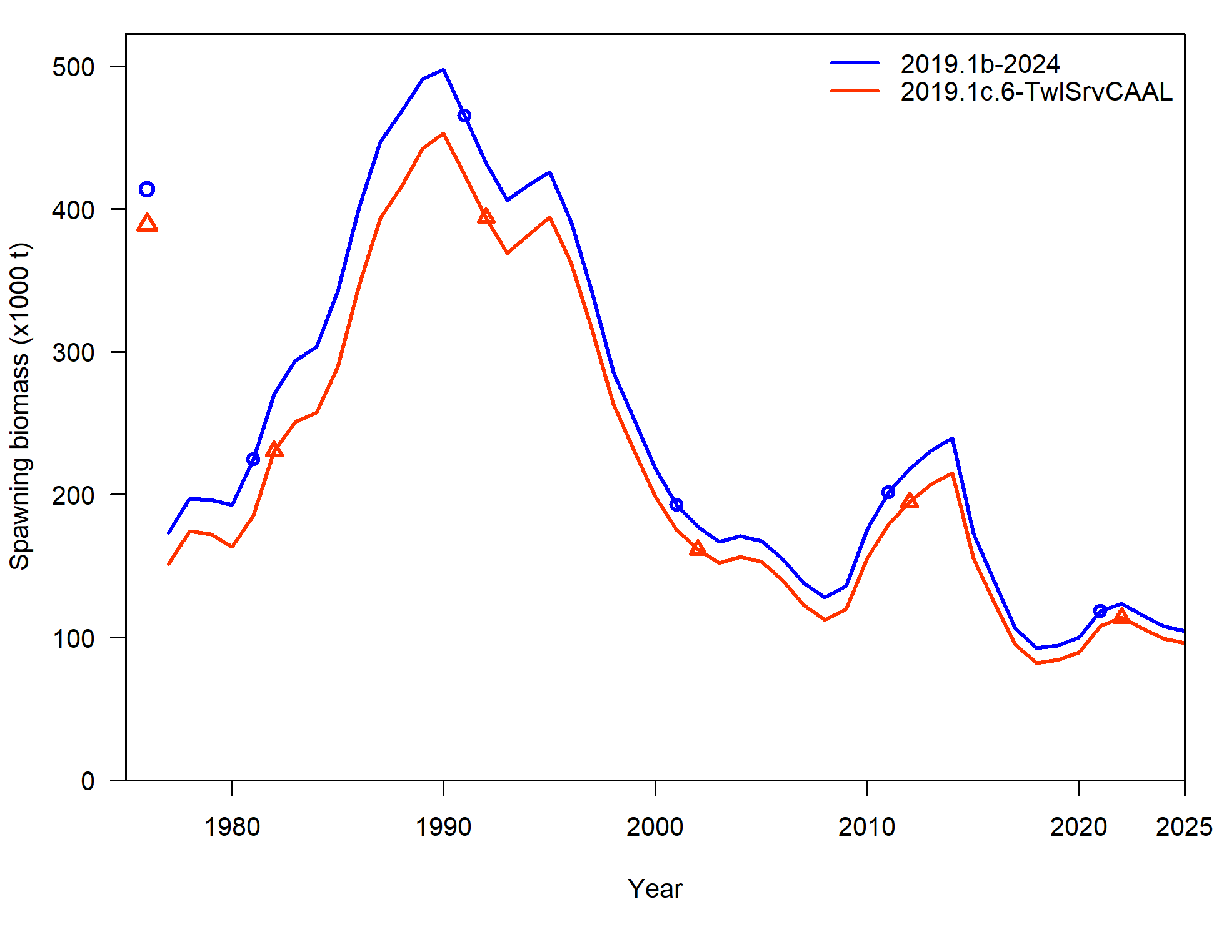
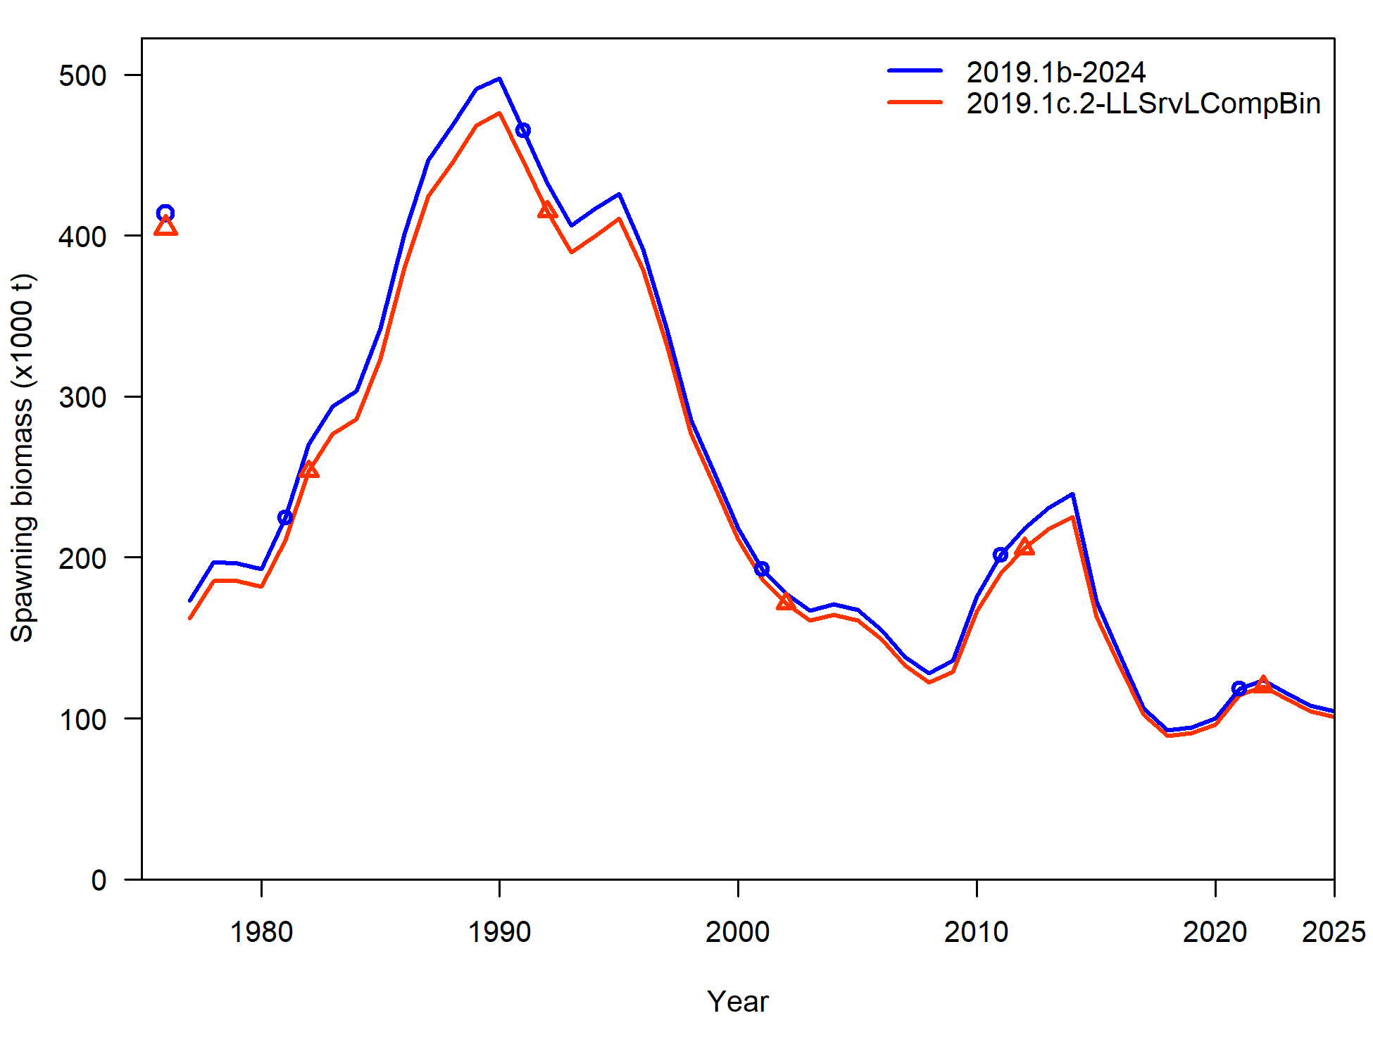
Input data file changes
Average % difference in SSB (from 2019.1b):
Model | %diff
2019.1c.1 | -0.06%
2019.1c.2 | -4.50%
2019.1c.3 | 0.20%
2019.1c.4 | 1.63%
2019.1c.5 | -0.33%
2019.1c.6 | -10.59%
2019.1c.7 | -0.05%

Slide 9
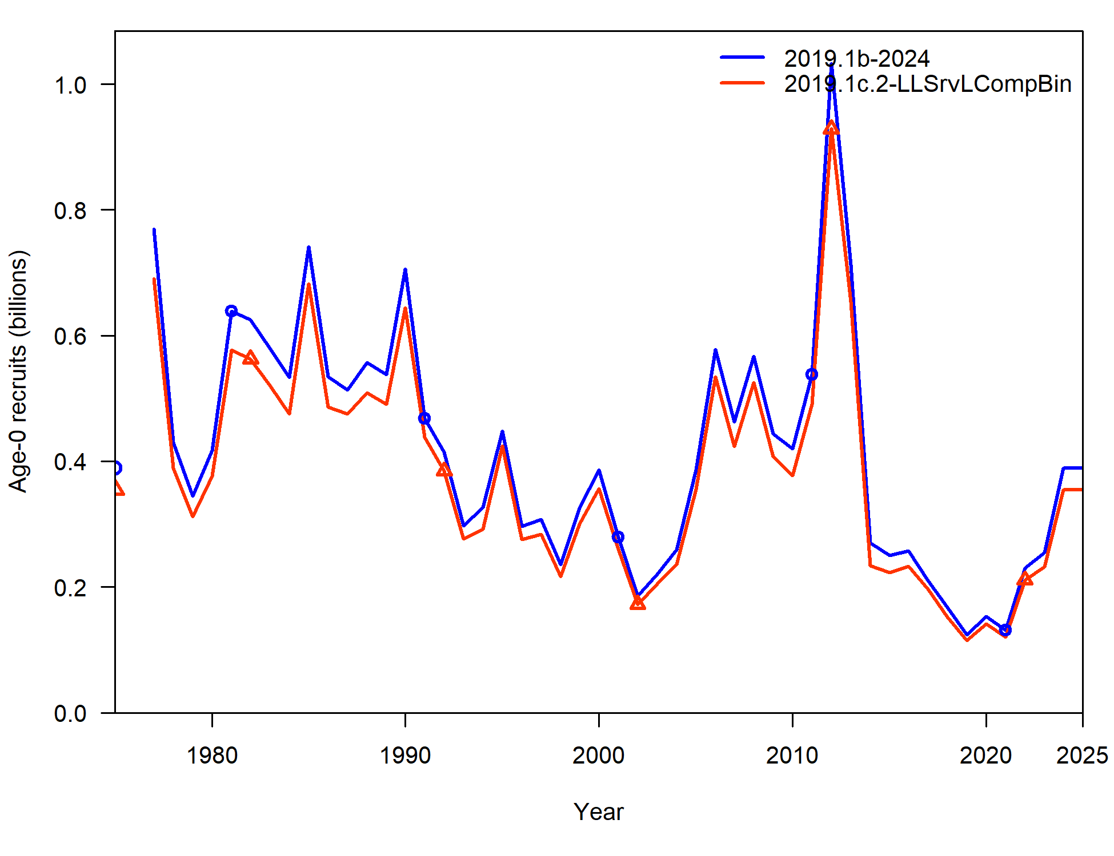
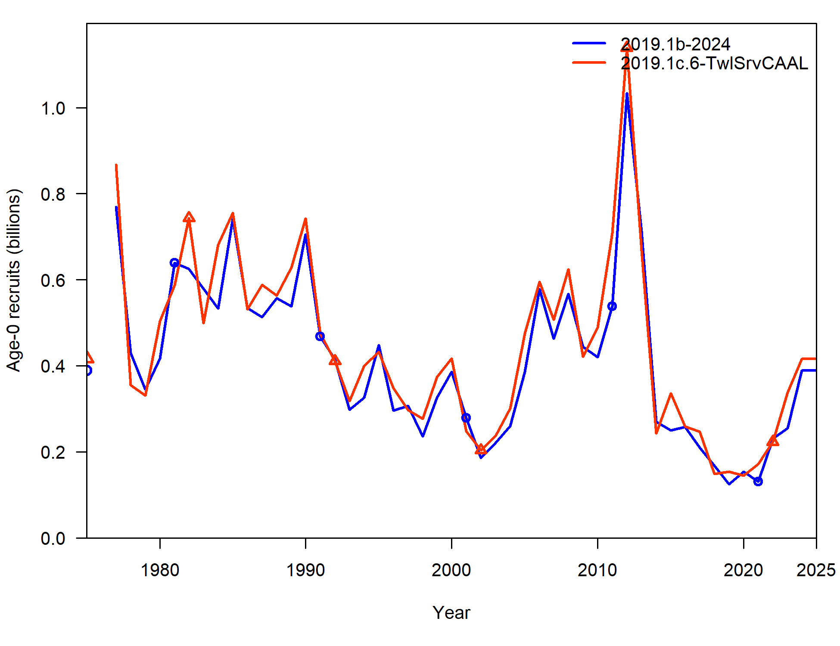
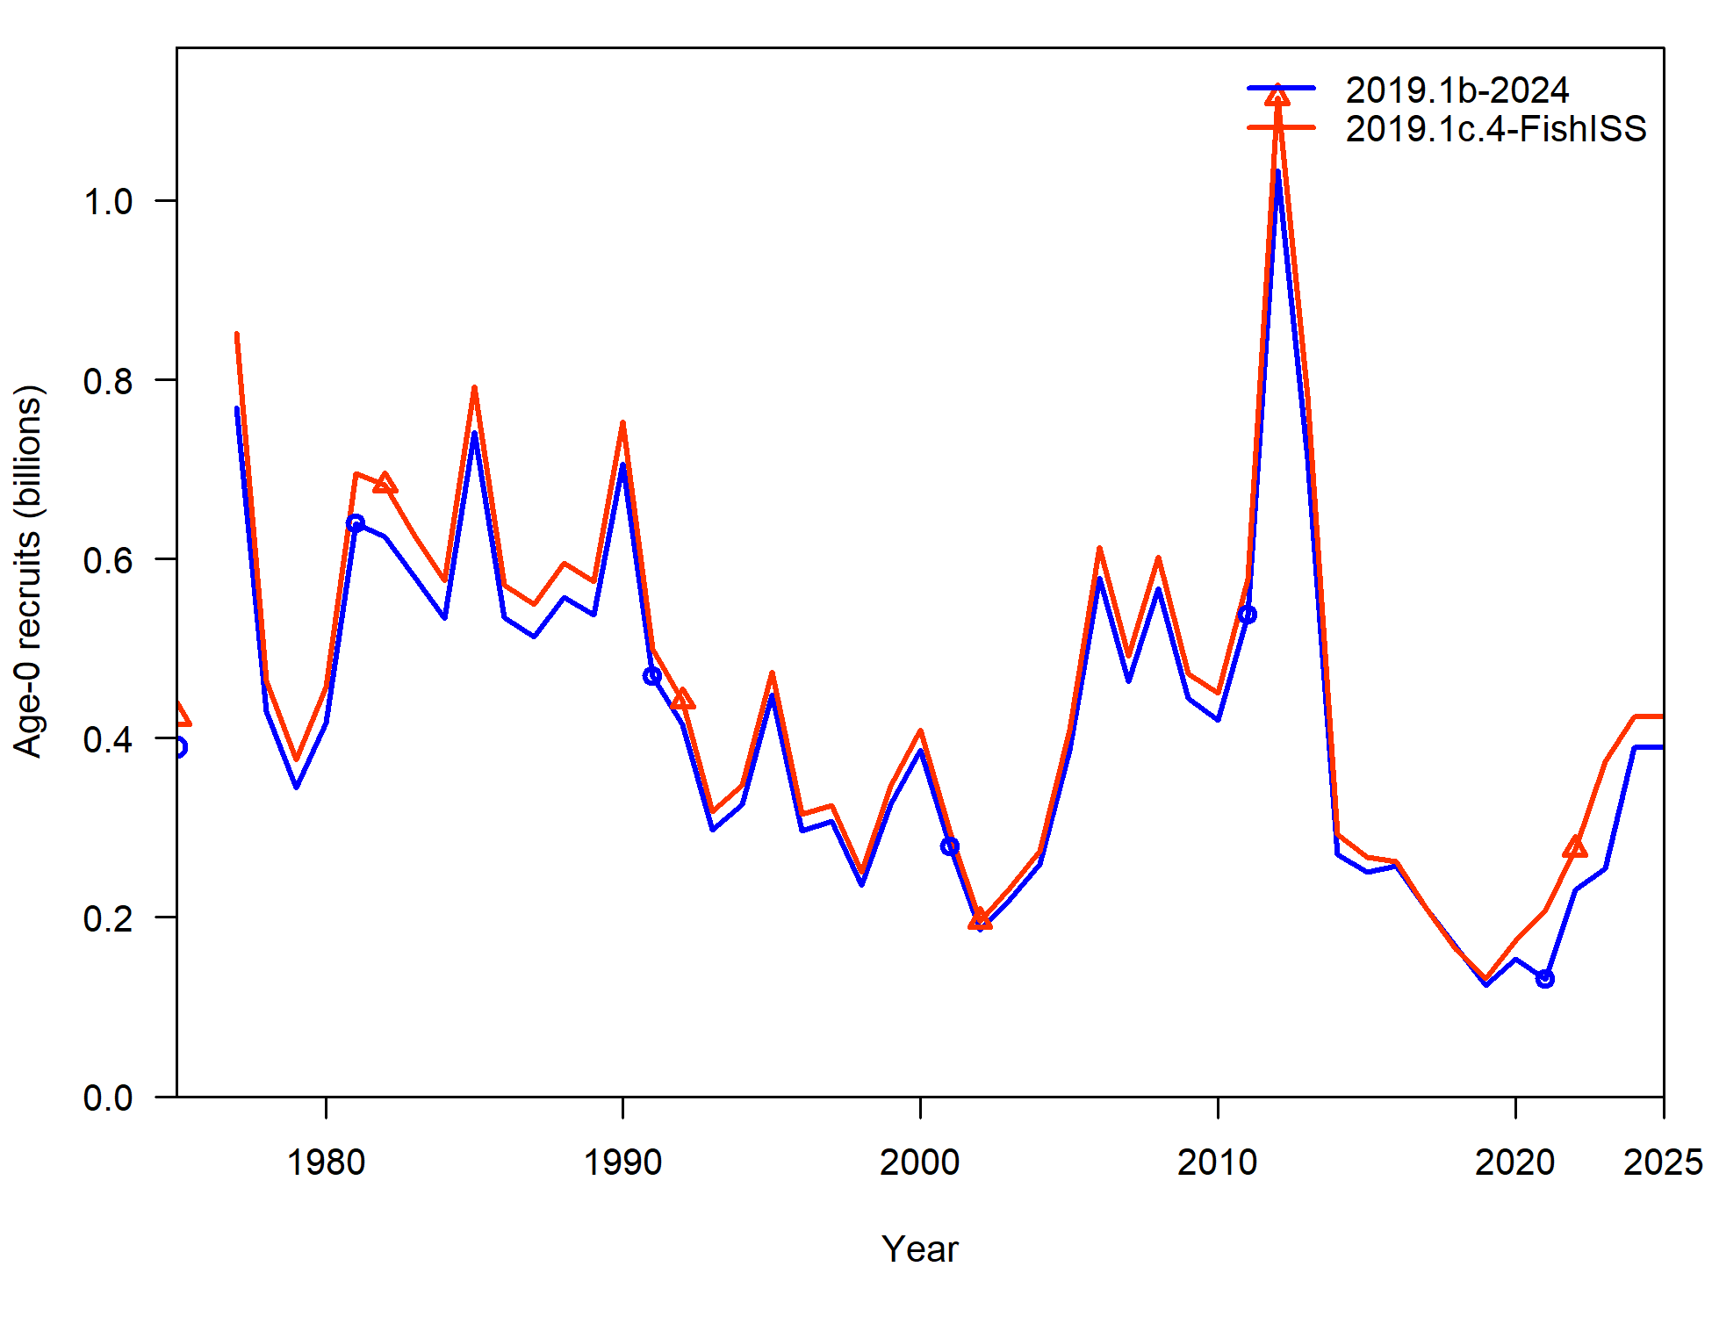
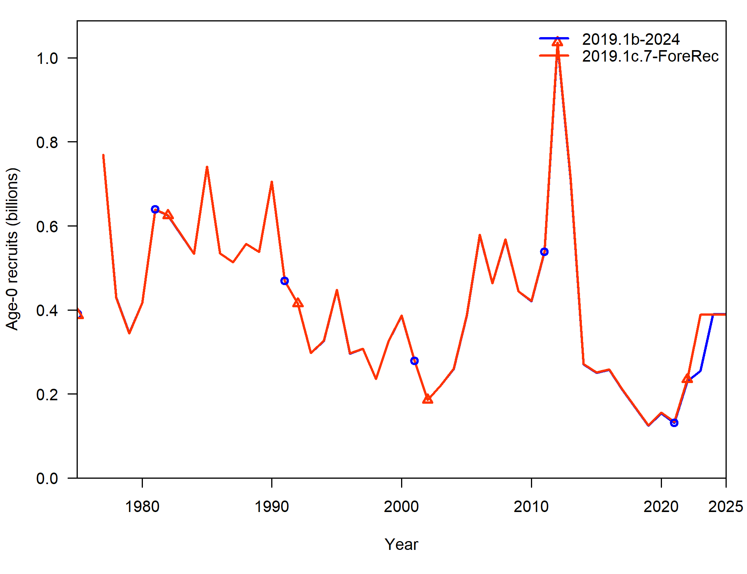
Input data file changes
Average % difference in Recruitment:
Model | %diff
2019.1c.1 | -0.09%
2019.1c.2 | -8.57%
2019.1c.3 | -0.89%
2019.1c.4 | 8.93%
2019.1c.5 | 0.79%
2019.1c.6 | 8.07%
2019.1c.7 | 1.30%

Slide 10
Input data file changes
Parameter | 2019.1b | 2019.1c | 2019.1c.2: LLSrvBin | 2019.1c.4: FishISS | 2019.1c.6: TwlCAAL
NatM | 0.46 | 0.47 | 0.45 | 0.47 | 0.46
NatM: 14-16 | 0.80 | 0.82 | 0.78 | 0.82 | 0.81
lnR | 12.87 | 12.99 | 12.78 | 12.96 | 12.94
q_twl | 1.07 | 1.19 | 1.12 | 1.07 | 1.19
q_ll | 1.06 | 1.08 | 1.04 | 1.05 | 1.15
q_llenv | 1.46 | 1.28 | 1.64 | 1.55 | 0.91
Neg log-likelihood components & key parameters:
Component | 2019.1b | 2019.1c.2: LLSrvBin | 2019.1c.4: FishISS | 2019.1c.6: TwlCAAL
TOTAL | 3050.99 | 3043.46 | 2915.88 | 3026.08
Catch | 1.21E-12 | 2.47E-12 | 1.17E-12 | 5.19E-12
Survey | -3.78 | -5.13 | -8.96 | -3.44
Length_comp | 1868.43 | 1861.86 | 1743.21 | 1866.58
Age_comp | 1180.16 | 1180.36 | 1177.15 | 1156.07
Recruitment | -4.86 | -4.93 | -5.97 | -3.95
InitEQ_Regime | 3.10 | 3.45 | 2.77 | 3.52
Forecast_Recruitment | 0.41 | 0.41 | 0.03 | 0.10
Parm_priors | 1.02 | 0.92 | 1.12 | 1.07
Parm_softbounds | 0.01 | 0.01 | 0.01 | 0.01
Parm_devs | 6.50 | 6.51 | 6.51 | 6.12

Slide 11
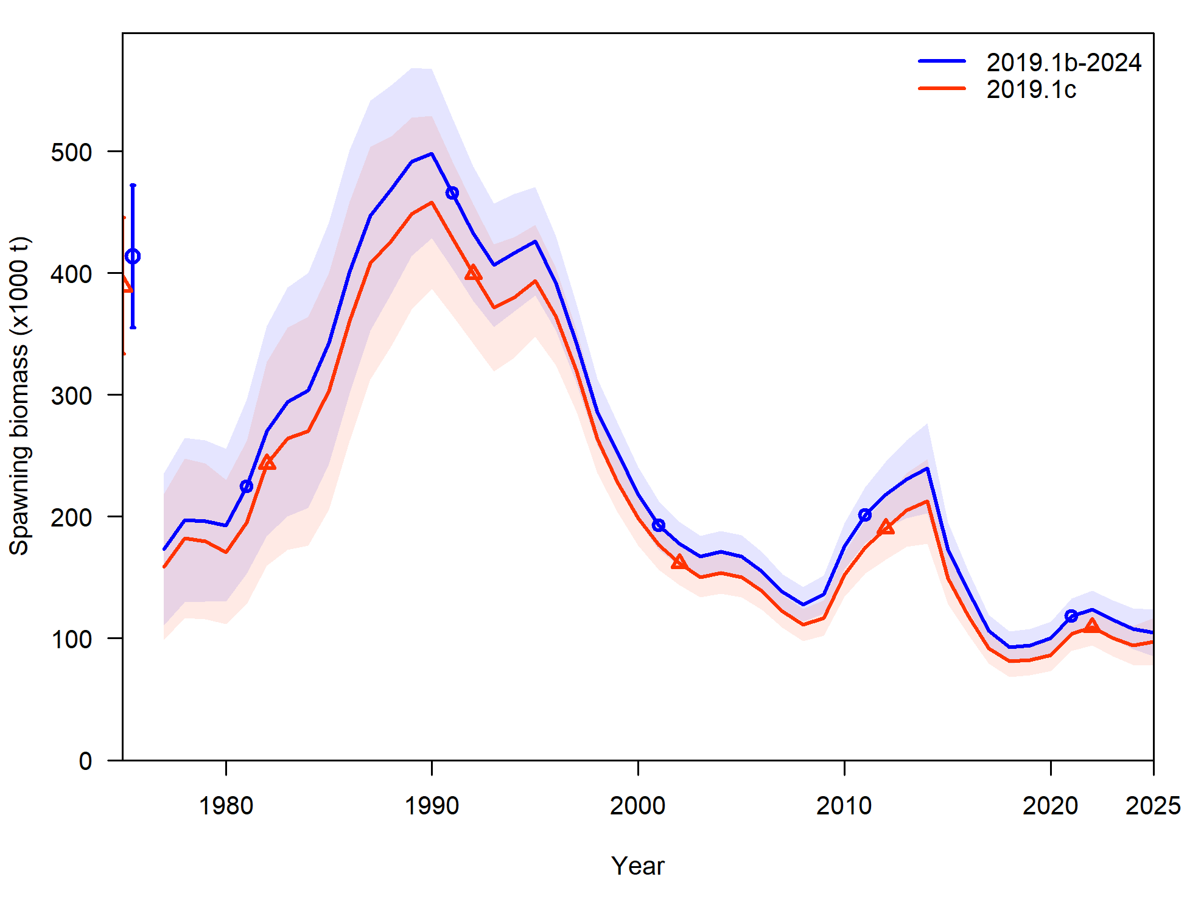
Input data file changes
Recommend input data changes
Provides a number of necessary corrections
Starts to increase consistency across cod assessments
Recommend new model 2019.1c

Slide 12
Recommended data updates (2019.1d)
Current ageing error:
Based on GOA reader-tester data up to 2017
No error for age-1 & 2, age-3 SD = 0.57 linear to age-10 SD = 1.16
Current ageing bias:
Bias for data pre-2007 implemented in Barbeaux et al. 2019
Estimates bias as unconstrained parameters at age-3 and age-10 (linear between)
Recommend update ageing error and ageing bias parameters

Slide 13
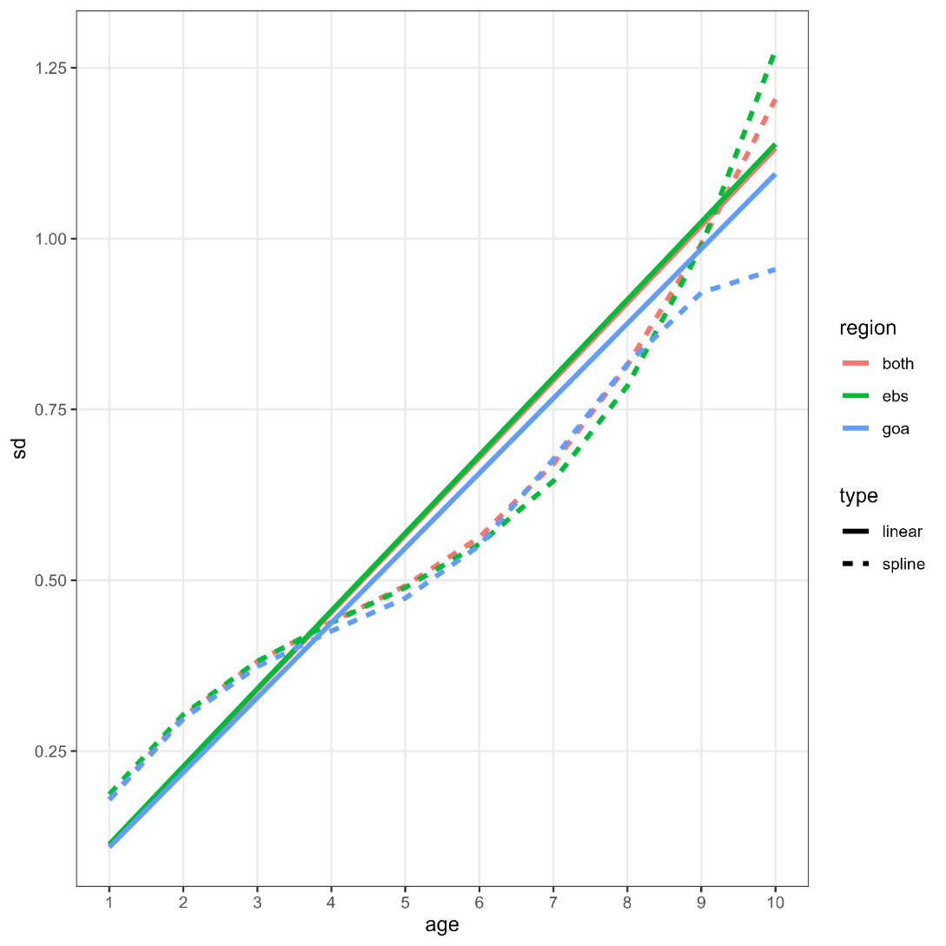
Recommended data updates (2019.1d)
Ageing error parameters:
Update reader-tester data through 2023 within AgeingError R-package
Pool GOA with EBS:
Minor differences between GOA and EBS for ages that have largest number of samples (age-4-8)
EBS has larger # of samples at edges (e.g., age-10)
Continue with linear method, use pooled EBS/GOA data, change to age-1 (SD = 0.11) through age-10 (SD = 1.13)

Slide 14
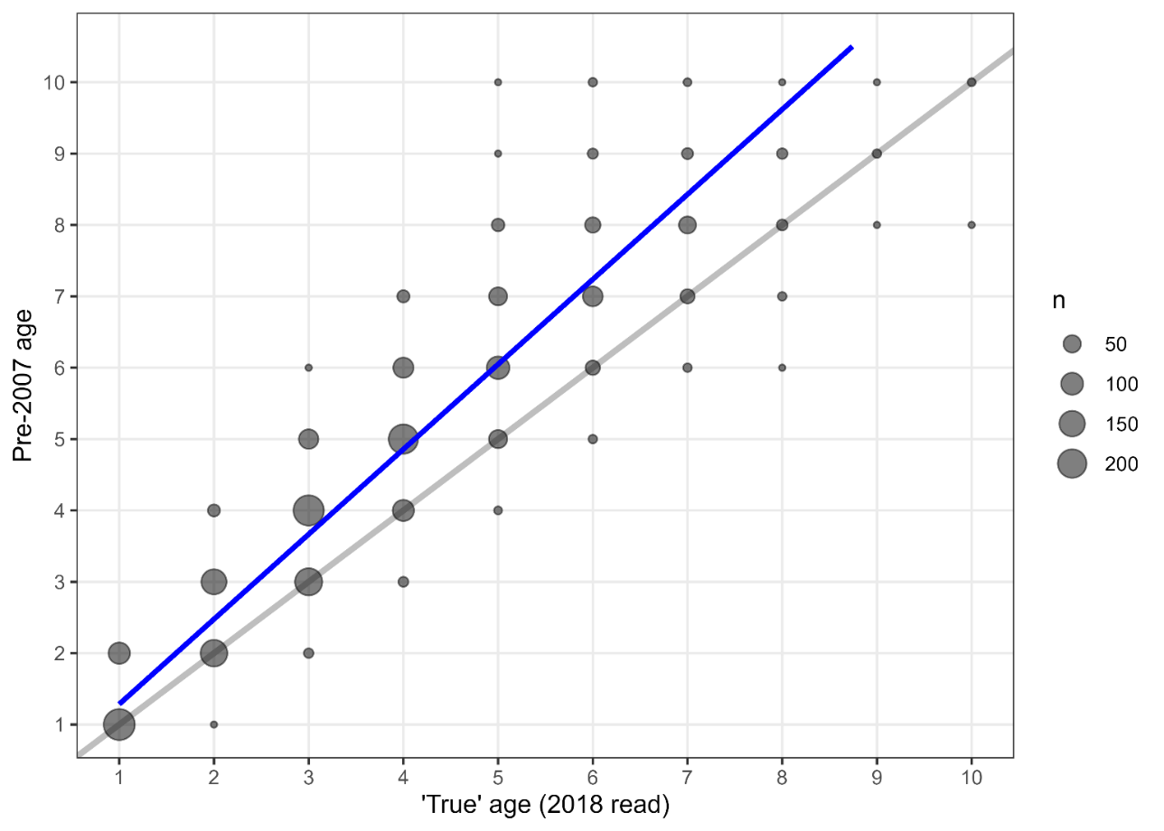
Recommended data updates (2019.1d)
Ageing bias parameters:
Used re-read data in 2018 to estimate ageing bias parameters pre-2007 with AgeingError R-package
Bias fixed (rather than estimated) at B = 0.24 for age-1 and B = 2.00 for age-10 with linear bias between

Slide 15
Recommended data updates (2019.1d)
Recommend updating ageing error: New model: 2019.1d
Decreases overall negative log-likelihood (CAAL largest component)
Slight increase in mean recruitment, increase in trawl survey catchability
Component | 2019.1b | 2019.1c | 2019.1d
TOTAL | 3050.99 | 2805.81 | 2727.26
Catch | 1.21E-12 | 5.98E-12 | 3.99E-12
Survey | -3.78 | -6.80 | -8.03
Length_comp | 1868.43 | 1704.53 | 1697.31
Age_comp | 1180.16 | 1100.23 | 1030.48
Recruitment | -4.86 | -2.55 | -2.96
InitEQ_Regime | 3.10 | 3.16 | 3.25
Forecast_Recruitment | 0.41 | -- | --
Parm_priors | 1.02 | 1.14 | 1.15
Parm_softbounds | 0.01 | 0.01 | 0.01
Parm_devs | 6.50 | 6.08 | 6.04
Parameter | 2019.1b | 2019.1c | 2019.1d
NatM | 0.46 | 0.47 | 0.48
NatM: 14-16 | 0.80 | 0.82 | 0.82
lnR | 12.87 | 12.99 | 13.03
q_twl | 1.07 | 1.19 | 1.23
q_ll | 1.06 | 1.08 | 1.11
q_llenv | 1.46 | 1.28 | 1.37

Slide 16
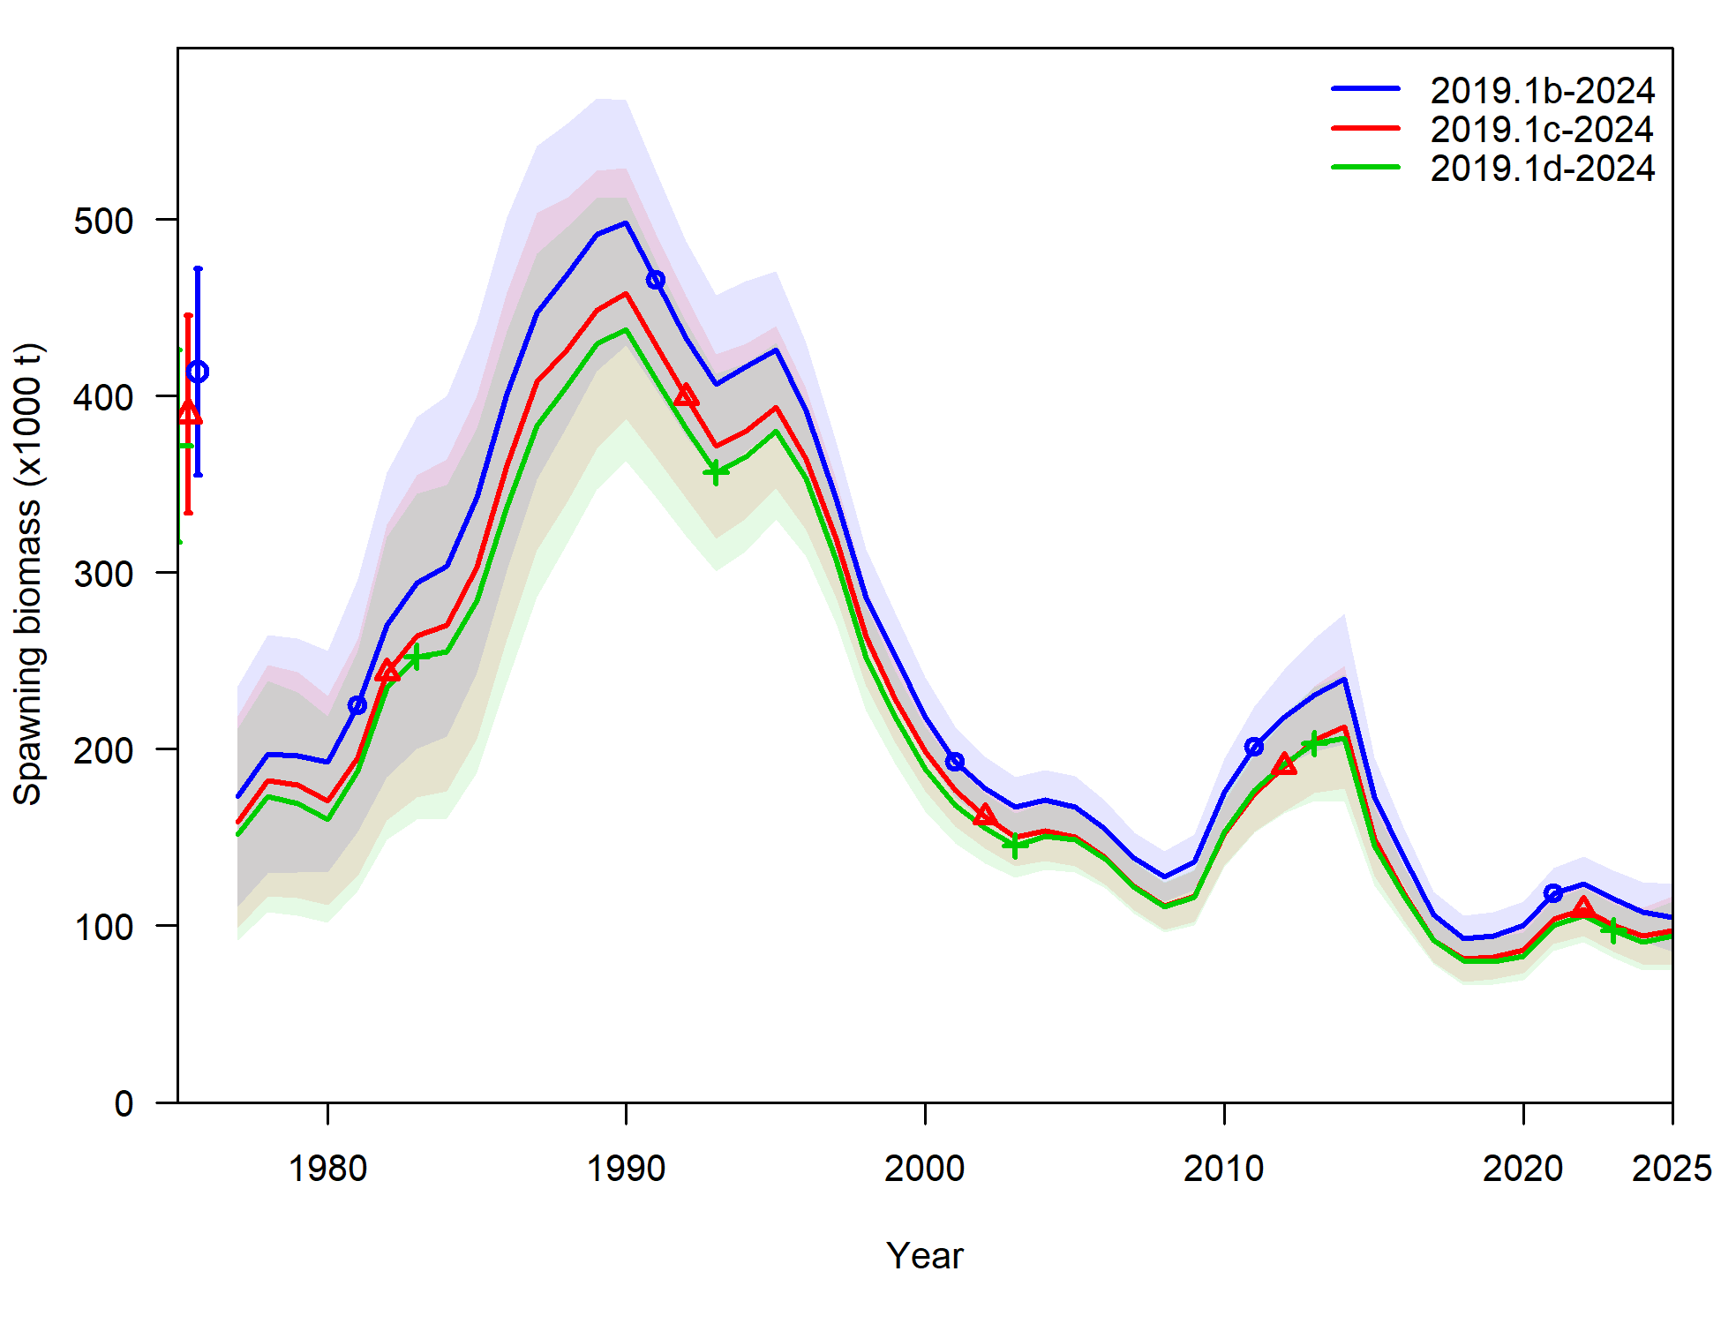
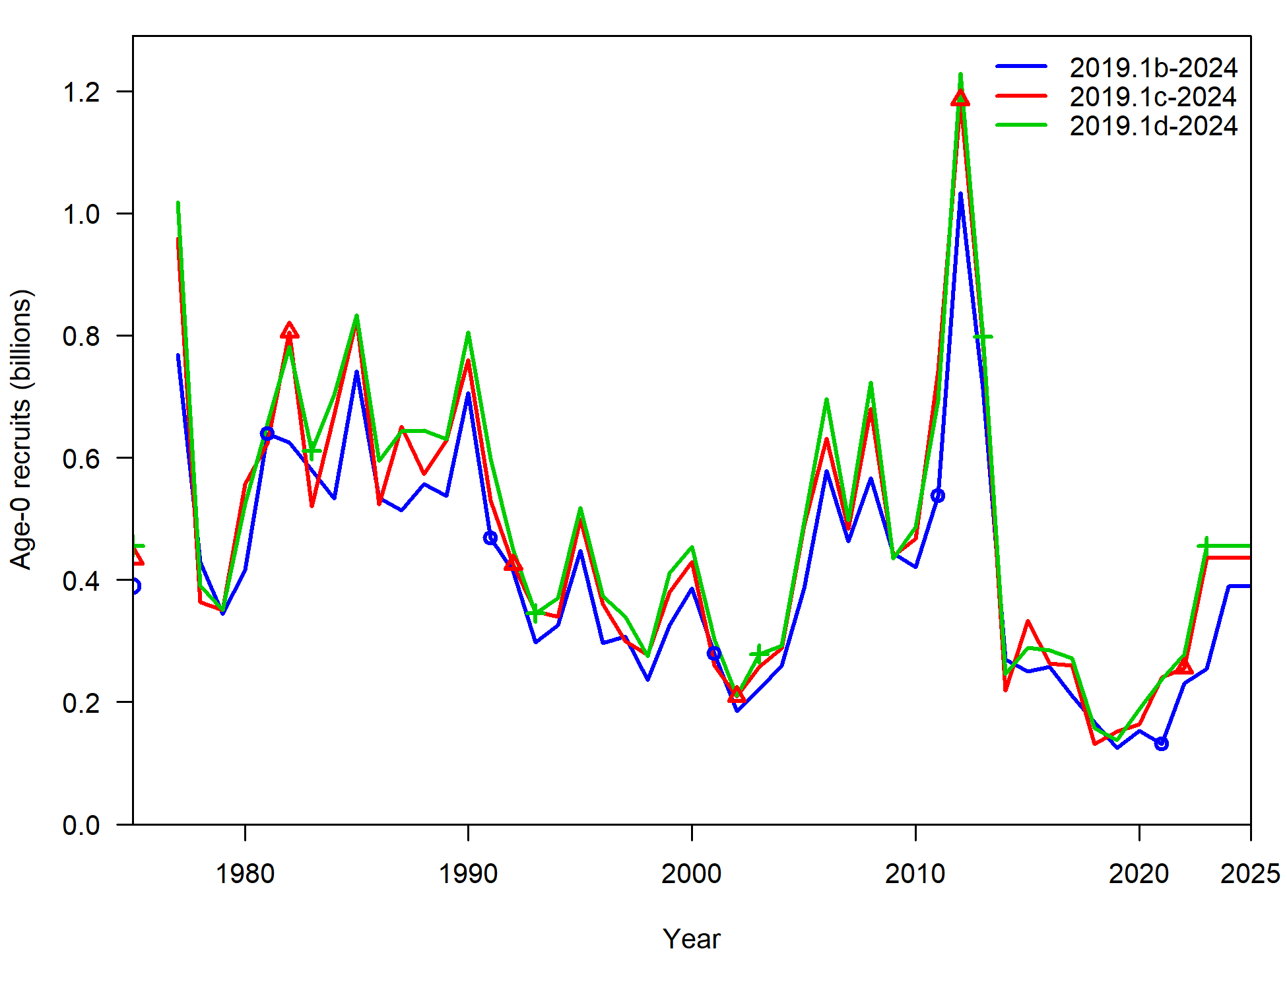
Recommended data updates (2019.1d)
Recommend updating ageing error: New model: 2019.1d

Slide 17
Fishery length comp investigations
In process of code redevelopment, took time to evaluate how fishery length comps computed
Reminder: have been having issue with increasing variability in recent data, particularly Pot fishery length comps
First, will walk through how fishery length comps have been previously computed

Slide 18
Fishery length comp overview
2 expansion methods used in GOA Pcod assessment:
Pre-1991 (includes foreign data)
Post-1991 (domestic data only)
Pre-1991:
Computes weighted length frequencies at haul level for foreign and domestic separately (weighted by extrapolated number in haul)
Sums across foreign and domestic weighted length frequencies at year-gear level, standardizes

Slide 19
Fishery length comp overview
2 expansion methods used in GOA Pcod assessment:
Pre-1991 (includes foreign data)
Post-1991 (domestic data only)
Post-1991:
Computes weighted length frequency in a haul across area and gear within each week (weighted by extrapolated number in haul)
Sums weighted length frequency within hauls to week-area-gear level, weights by proportion of catch within each week-area-gear / catch by year-gear (catch in tons)
Sums to trimester-area-gear, fills in State data where there is no Federal data
Sums to year-gear, standardizes

Slide 20
Fishery length comp investigations: filtering
Post-91 data filtering: >10 per haul in fed data
Proportion of hauls removed:
 | Longline | Pot | Trawl
1991-2012 | 2% | 4% | 3%
2013 | 12% | 12% | 2%
2014 | 6% | 14% | 5%
2015 | 5% | 8% | 4%
2016 | 13% | 10% | 4%
2017 | 12% | 12% | 20%
2018 | 23% | 6% | 6%
2019 | 22% | 10% | 6%
2020 | 60% | -- | 79%
2021 | 20% | 14% | 72%
2022 | 6% | 30% | 76%
2023 | 34% | 36% | 68%

Slide 21
Fishery length comp investigations: State data
State data used to ‘fill-in’ missing federal observer data:
2 steps:
Step 1: filters state data to more than 30 lengths observed (at trimester-area-gear level) – very few filtered out, most for 90s trawl data
Step 2: uses state data if fed data missing for that trimester-area-gear combo
% data used | Longline | Pot | Trawl
1997-2016 | 35% | 19% | 38%
2017 | 33% | 0% | --
2018 | 40% | 33% | --
2019 | 40% | 50% | --
2020 | 100% | 100% | --
2021 | 67% | 67% | --
2022 | 60% | 0% | --
2023 | 50% | 100% | --

Slide 22
Fishery length comp investigations
Post-91 data filtering: >10 per haul in fed data
Propose: remove filter and include all data
Why?
Increasing number of hauls that get filtered, don’t expect that to change any time soon
Increased variability in length comps with smaller number of fish sampled within a haul not a reason to remove data, would be expected and working on methods to be able to capture/quantify that variability
Given stock status, need as much data as we can get to understand demographics of fish captured in fishery

Slide 23
Fishery length comp investigations
State data used to ‘fill-in’ missing fed data
Propose: rather than ‘fill-in’, merge with fed data
Why?
State fishery landings are included within total catch removals fit within assessment model – would want estimated selectivity to be fit to composition data that is reflective of the removal data
Hasn’t been used: (1) because wasn’t really needed given magnitude of federal data, and (2) because it resulted in differences with federal data
Increased variability in length comps because of difference in length comp across fleets/sectors not a reason to not use data, would be expected and working on methods to be able to capture/quantify that variability
Given stock status, need as much data as we can get to understand demographics of fish captured in fishery

Slide 24
Fishery length comp investigations
Current method to expand fishery length comps complex and granular
Propose: simplify and expand from month-area-gear level rather than week-area-gear
Why?
To merge State data, requires restructure of how fed length comp data computed – week-area-gear level of granularity not available in state data
Granularity due to account for cod growth throughout year, month vs week can still account for that
Quantity of data in recent years may not support this level of expansion
Using 2019.1d as base model: 2019.1e

Slide 25
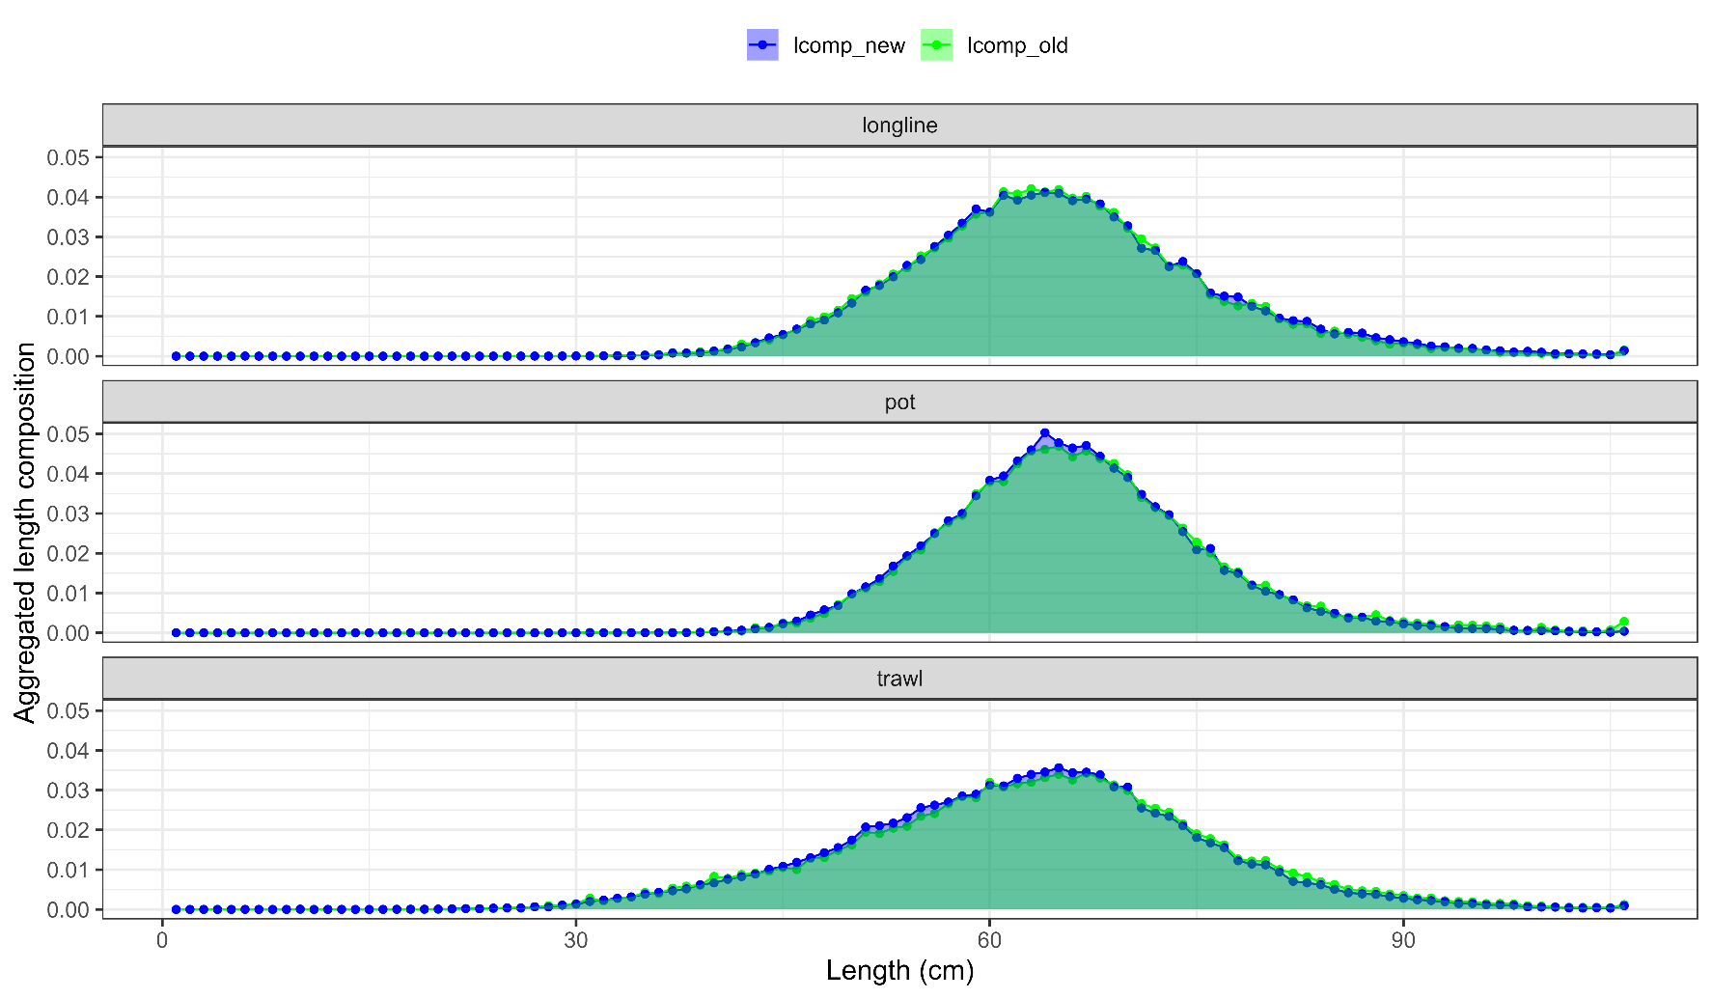
Fishery length comp investigations
Aggregated length comps: some subtle differences, but overall not that different

Slide 26
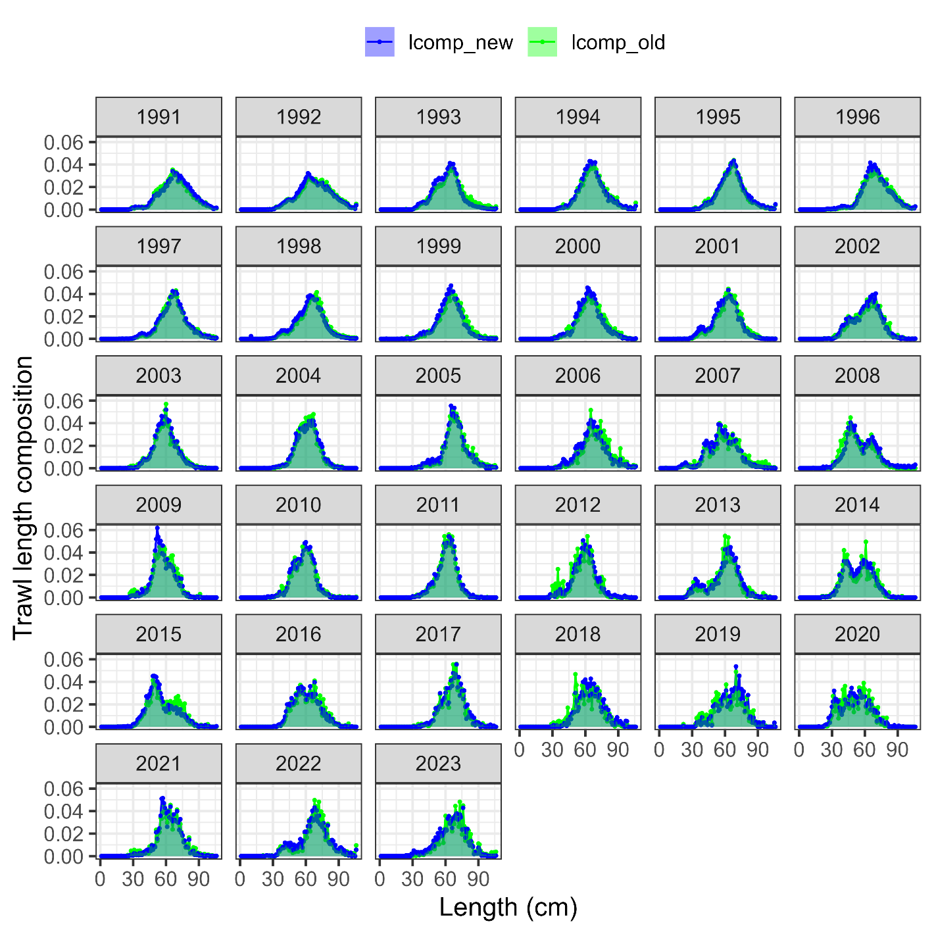
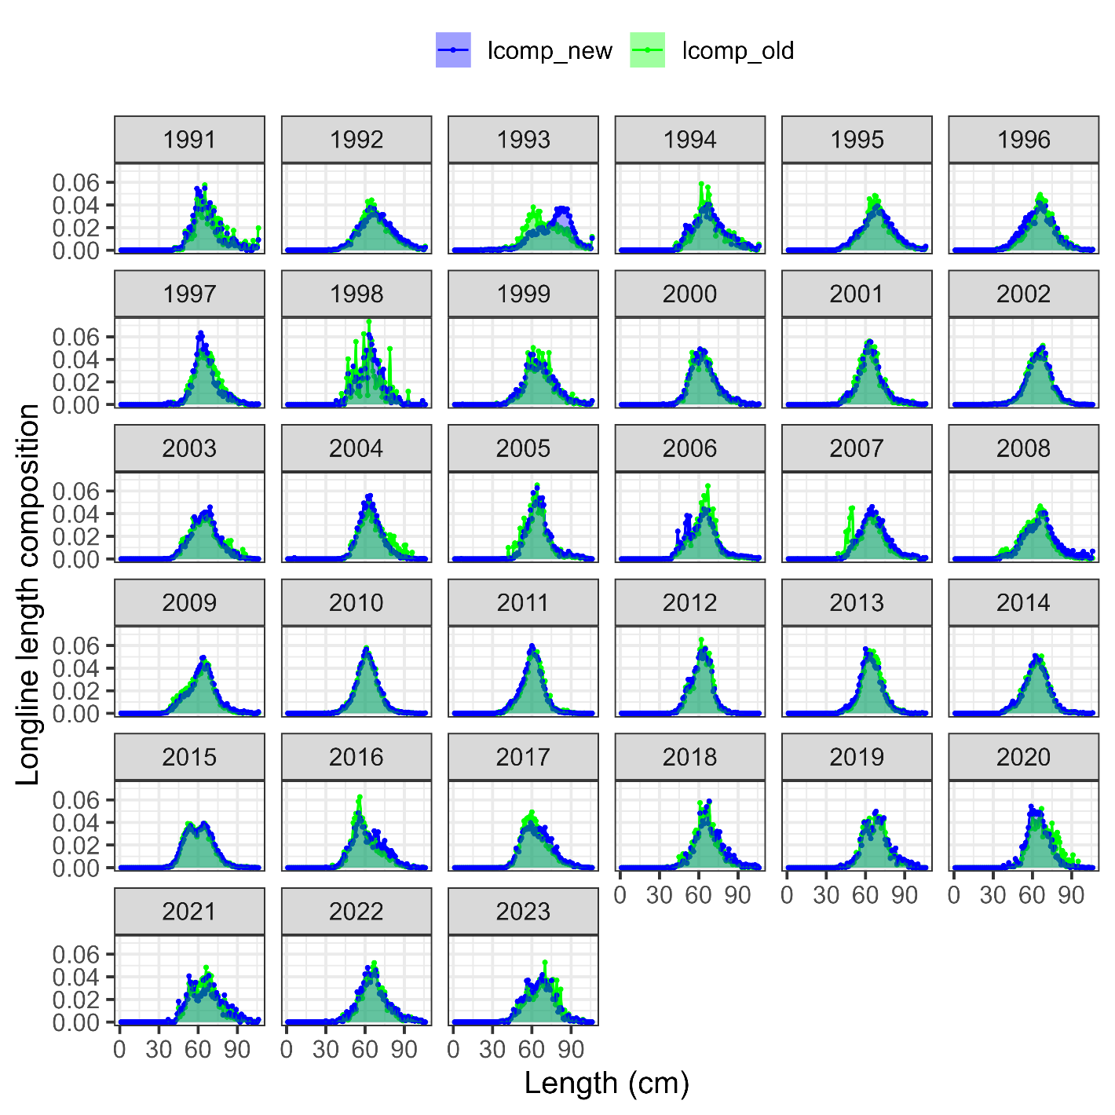

Slide 27
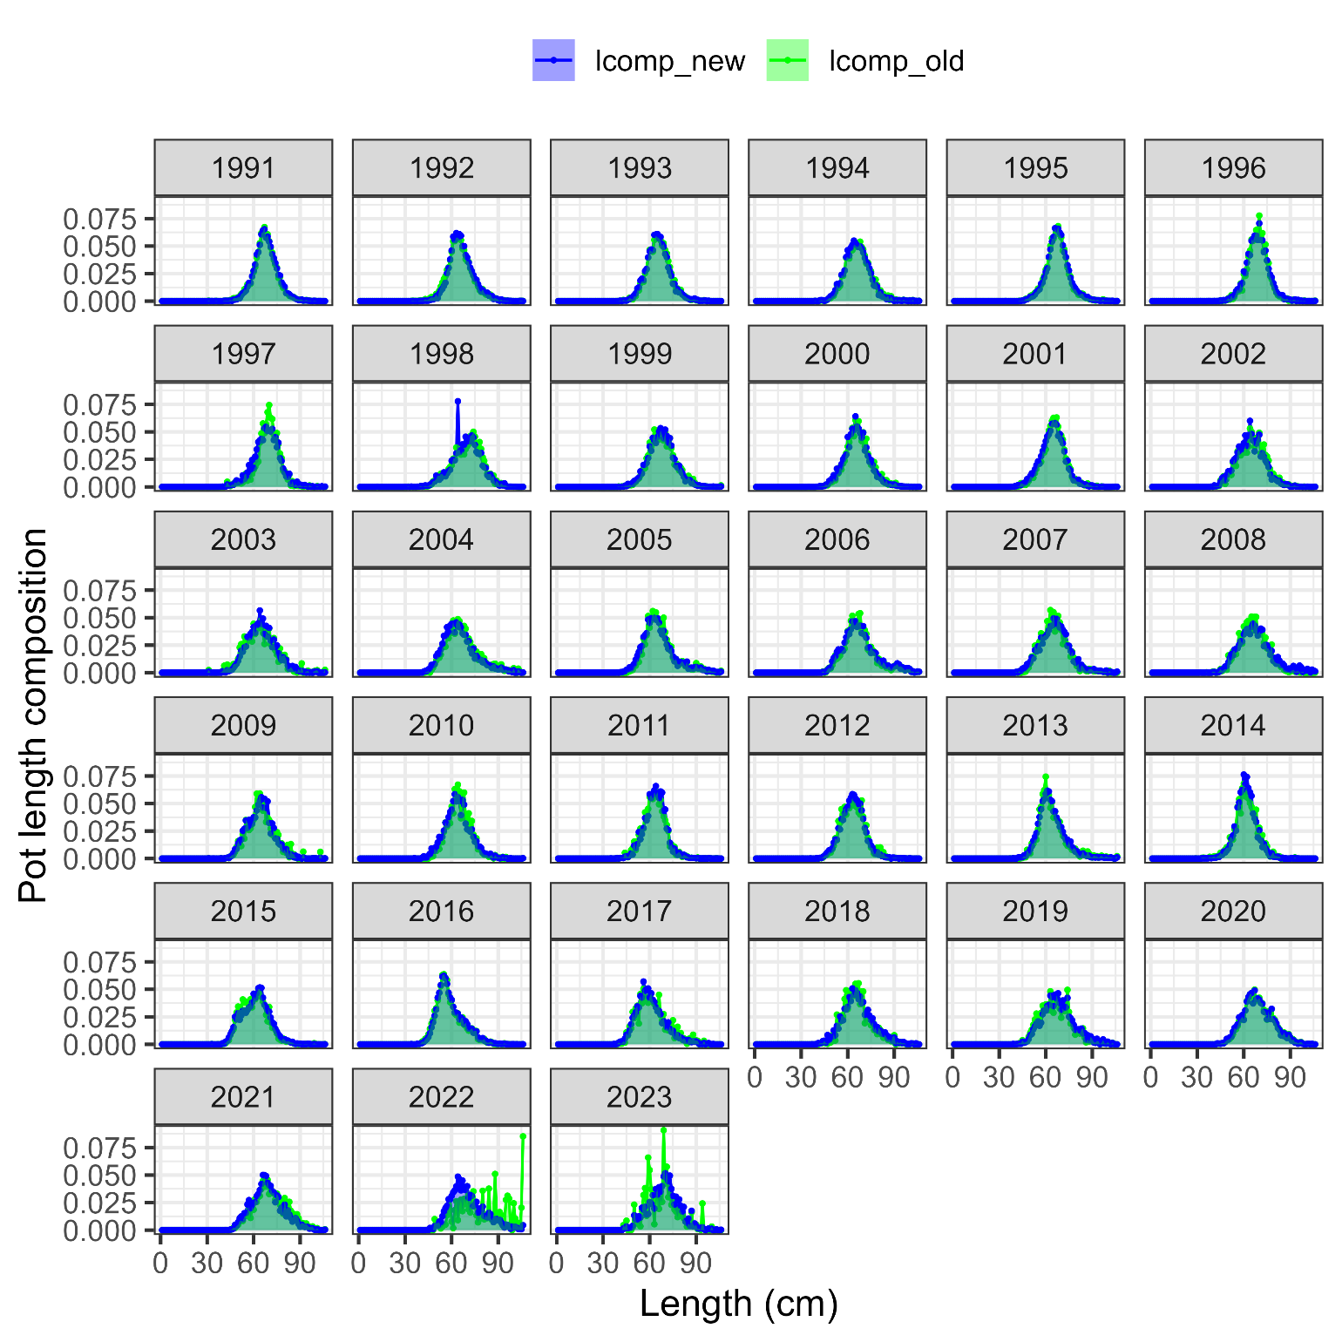

Slide 28
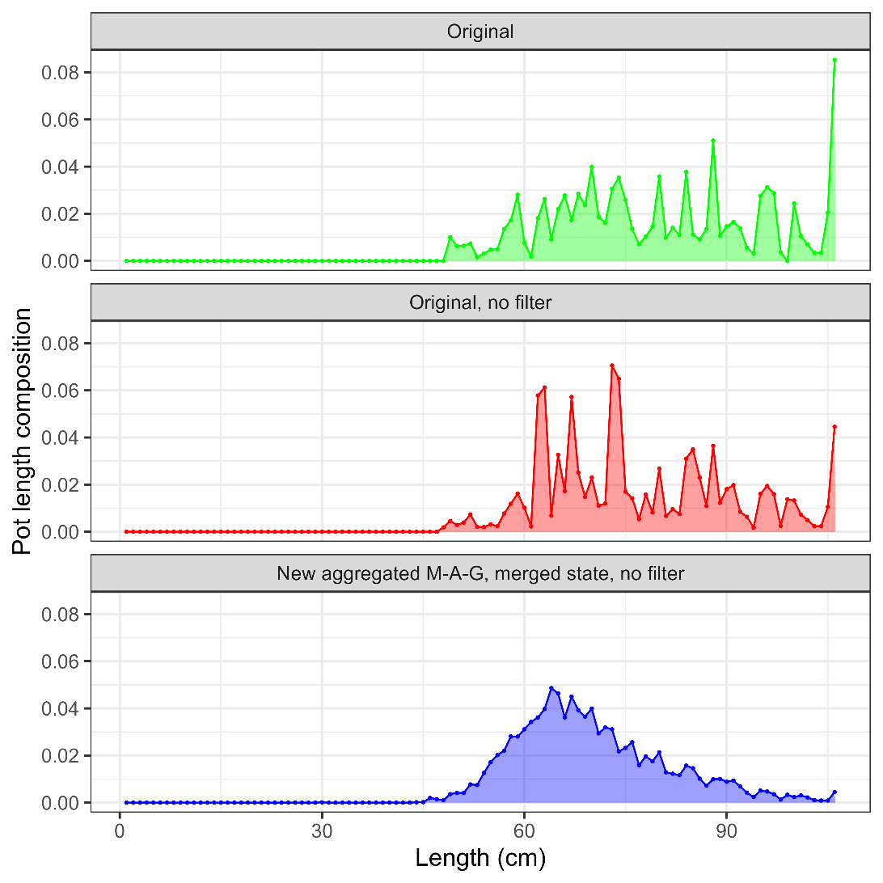
37 hauls
n = 698
No state
53 hauls
n = 794
No state
n = 6417
With state

Slide 29
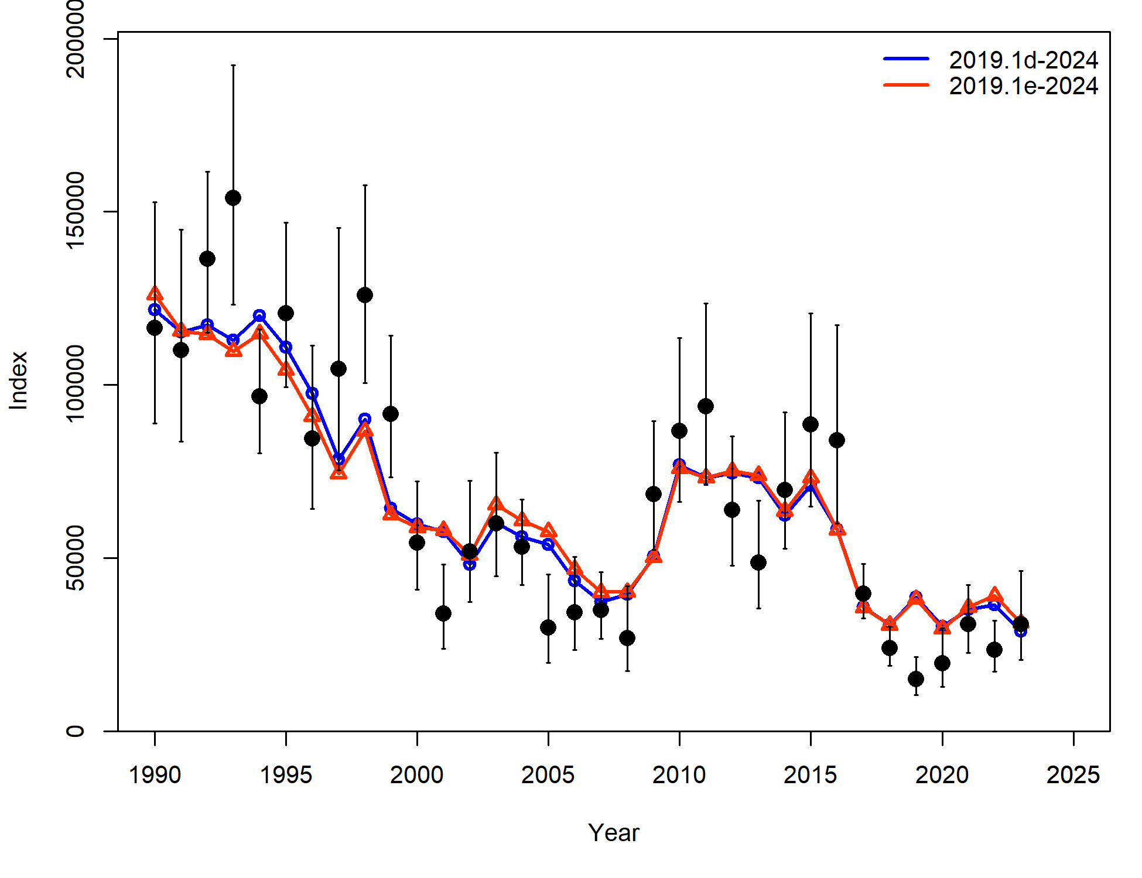
Fishery length comp investigations
Increase in negative log-likelihood value for surveys (due to longline survey fit), decrease for length comps
 | 2019.1d | 2019.1e
ALL | -8.03 | 0.63
Srv | -7.19 | -5.23
LLSrv | -0.84 | 5.86
Component | 2019.1d | 2019.1e
TOTAL | 2727.26 | 2715.80
Catch | 3.99E-12 | 2.44E-12
Survey | -8.03 | 0.63
Length_comp | 1697.31 | 1676.90
Age_comp | 1030.48 | 1030.97
Recruitment | -2.96 | -3.03
InitEQ_Regime | 3.25 | 3.17
Parm_priors | 1.15 | 1.16
Parm_softbounds | 0.01 | 0.01
Parm_devs | 6.04 | 6.00

Slide 30
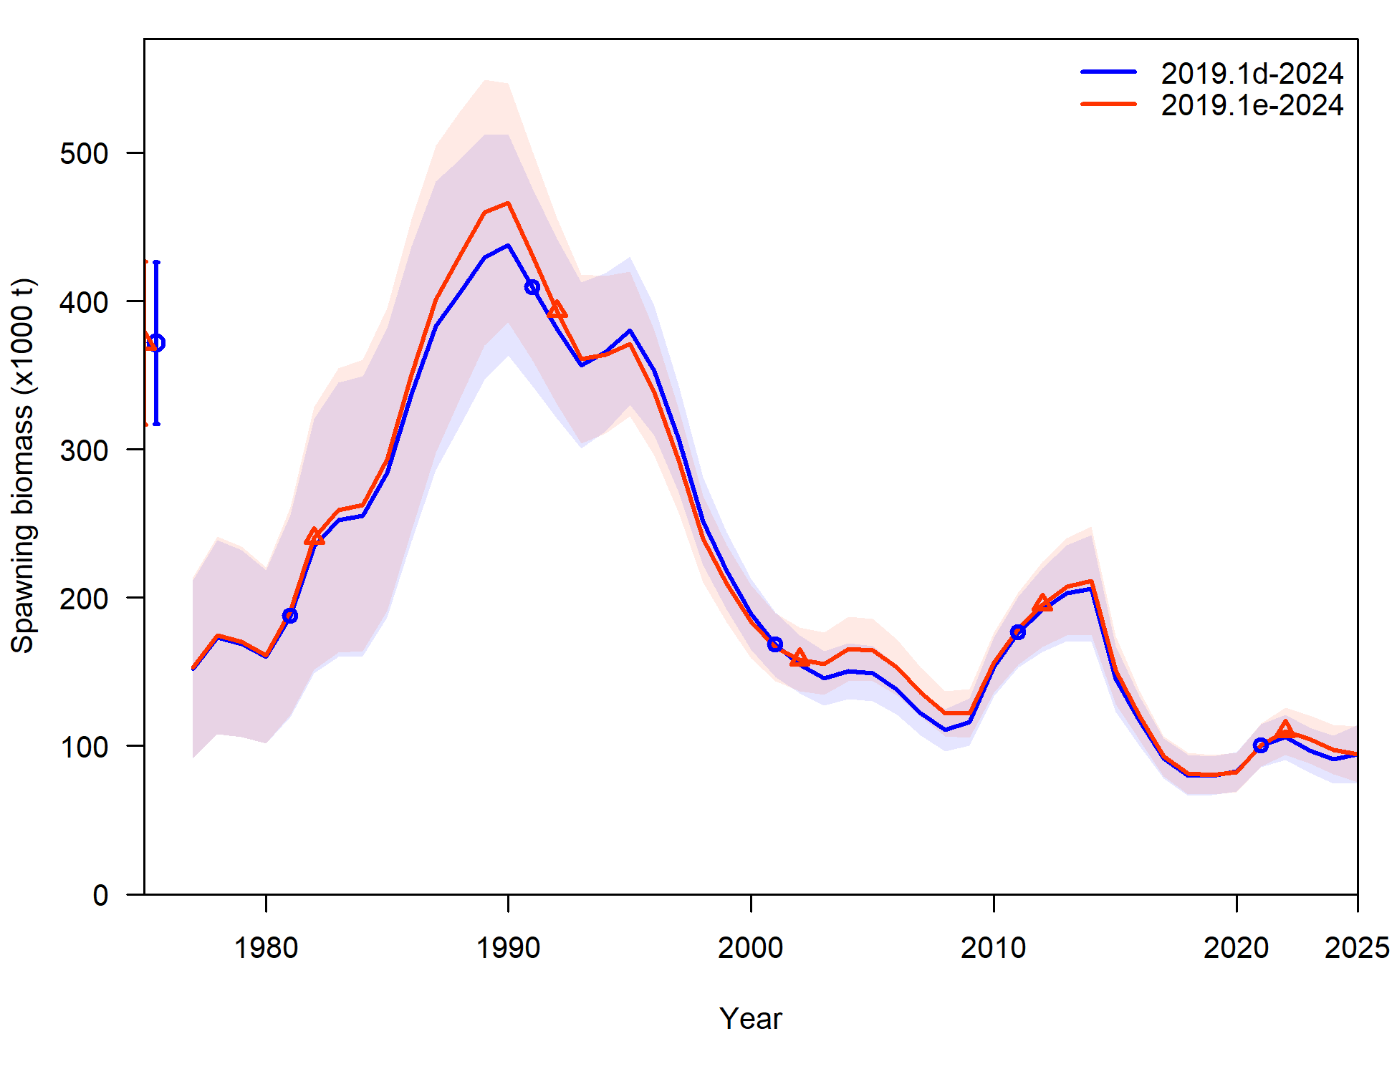
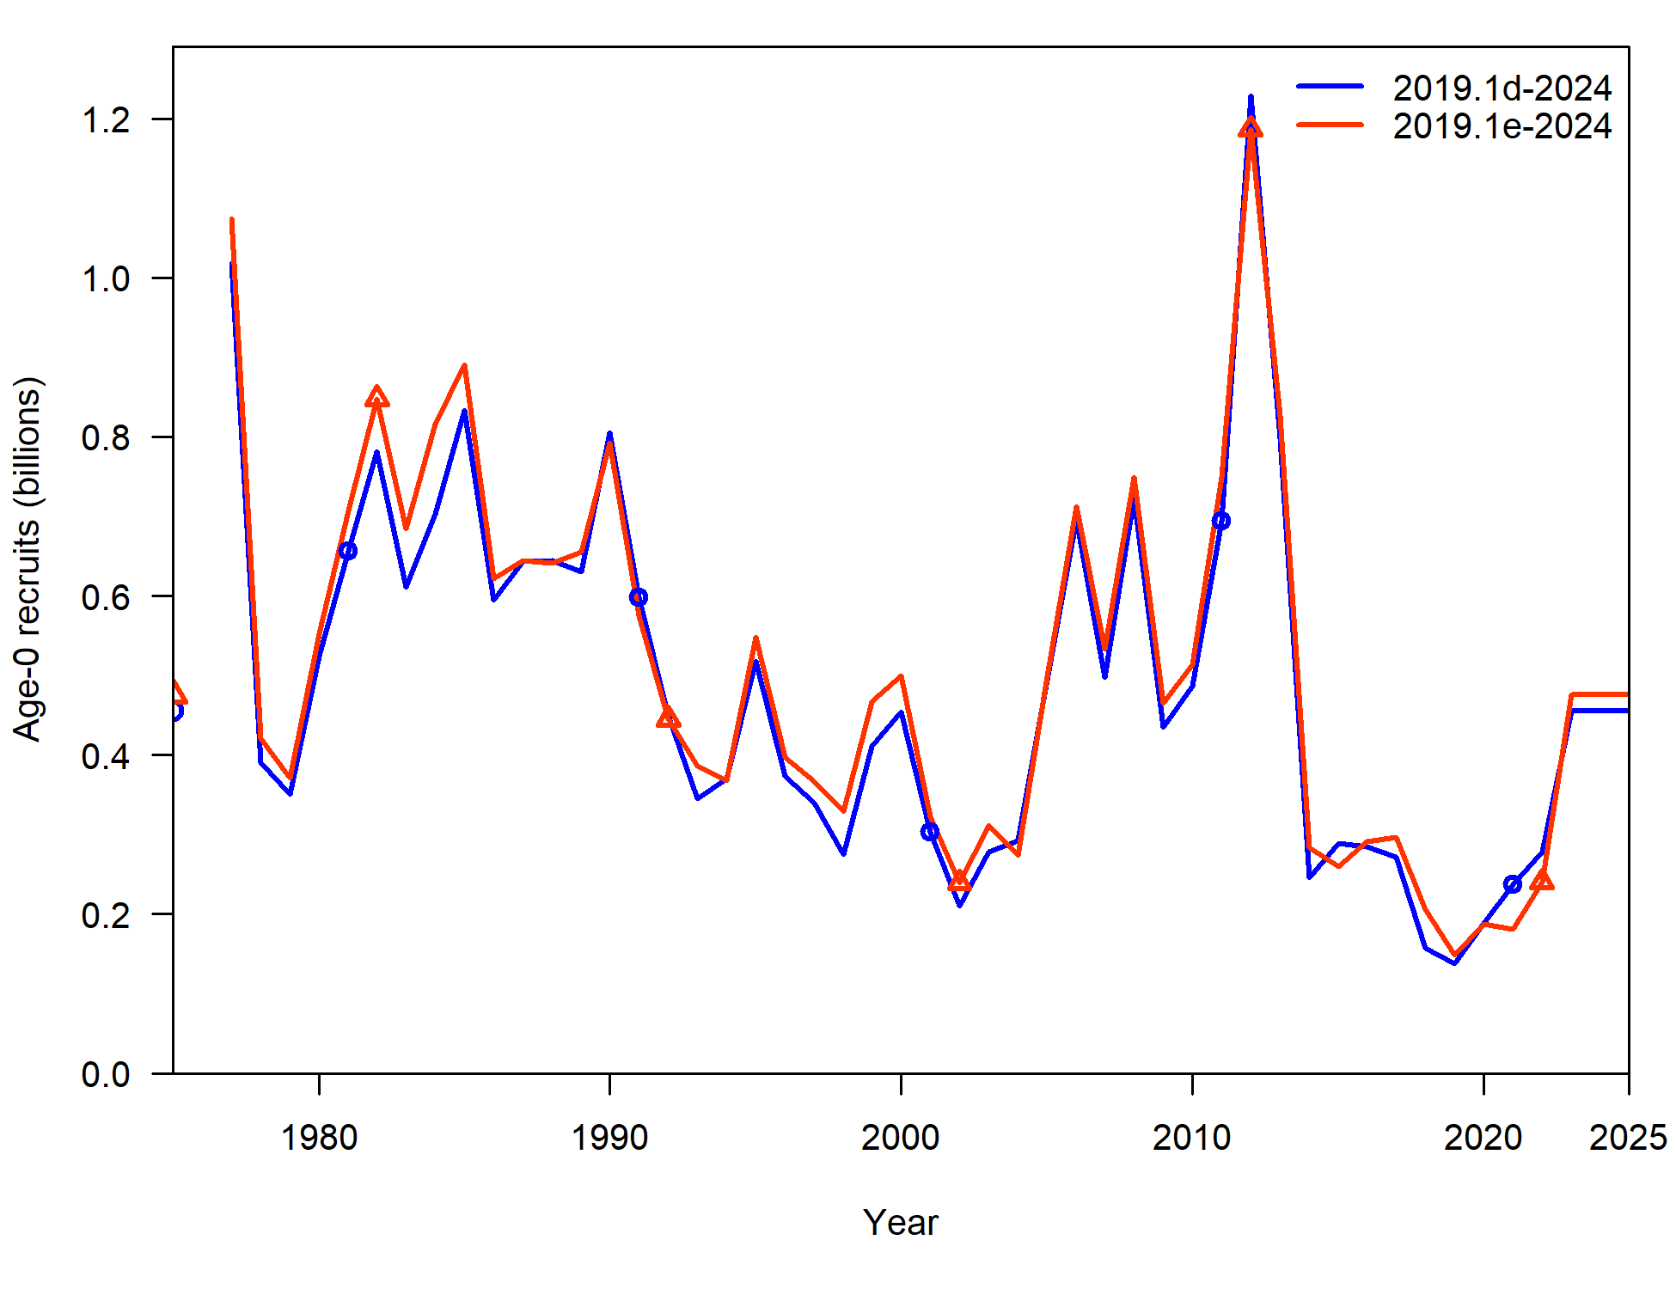
Fishery length comp investigations
Not a dramatic change in SSB or recruitment estimate trends, though differences in some years

Slide 31
Fishery length comp investigations
In general, removing filters, aggregating at month-area-gear level and merging state data helps to smooth out much of the variability in fishery length comps, particularly in recent years
Provides a simpler method and leverages all sources of available data to inform model estimates
There are some differences in model fit and estimates, but no dramatic changes
In order to remove variability in fishery length comps and leverage information contained within State length sampling data, Recommend new model 2019.1e

Slide 32
Length composition binning
But, only gets us so far, there remains variability across lengths in length comp data
Propose: align with EBS cod investigations this year, and investigate binning length data
2 cm bins – 2019.1e.2cm
5 cm bins – 2019.1e.5cm
Affects: all length comp and conditional age-at-length for surveys and fishery fleets

Slide 33
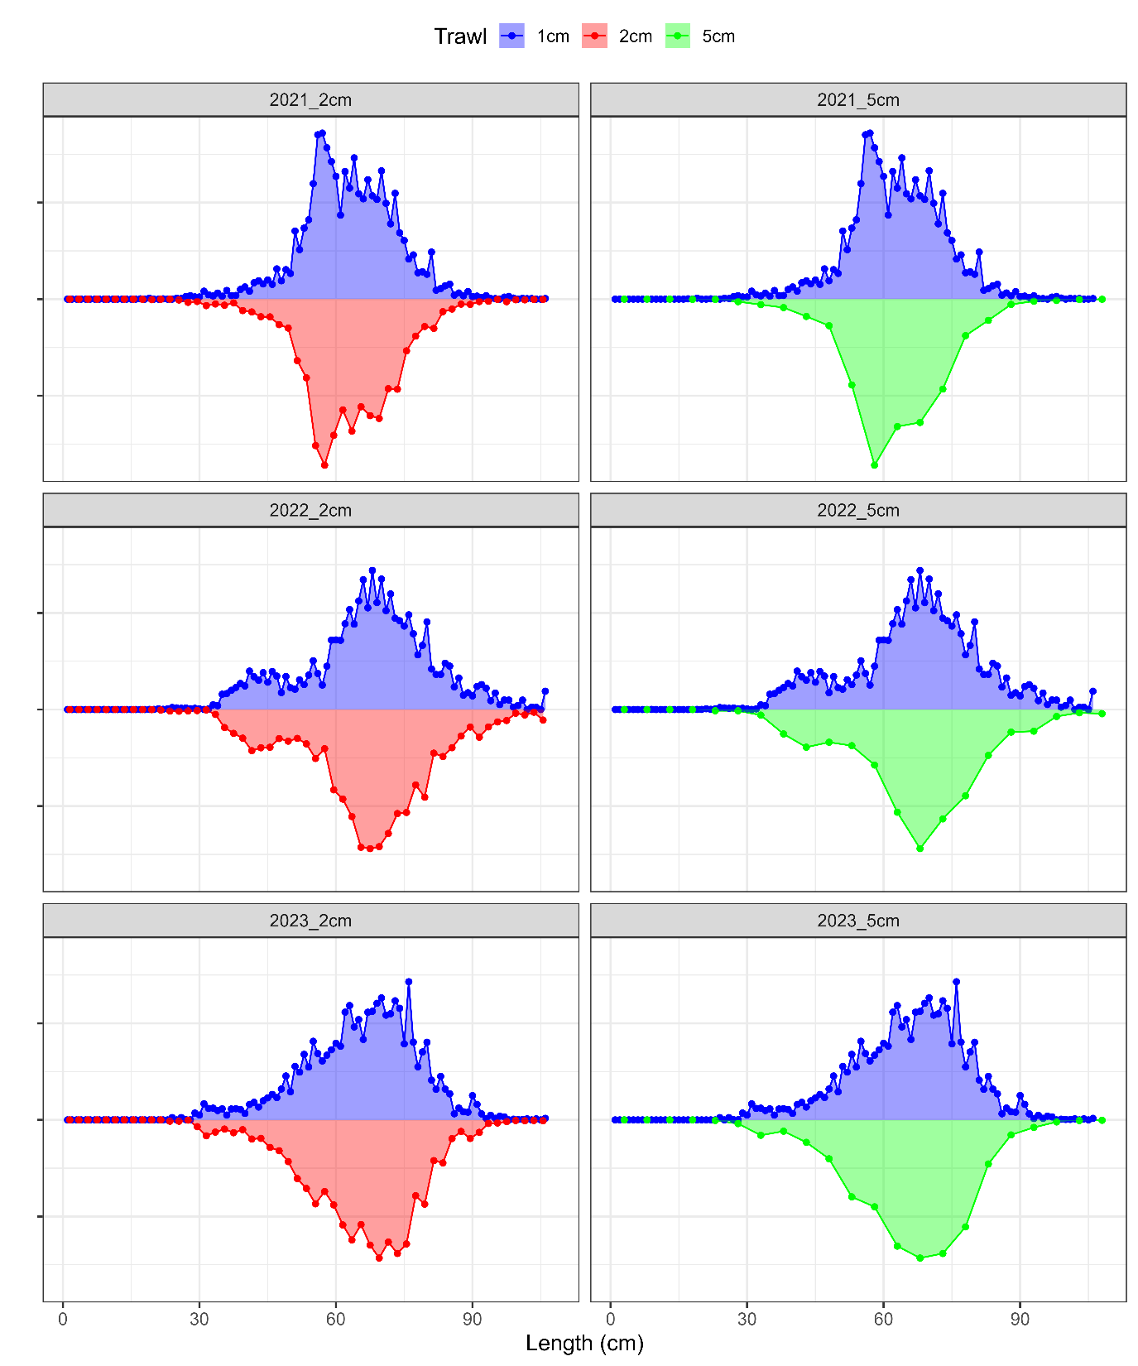
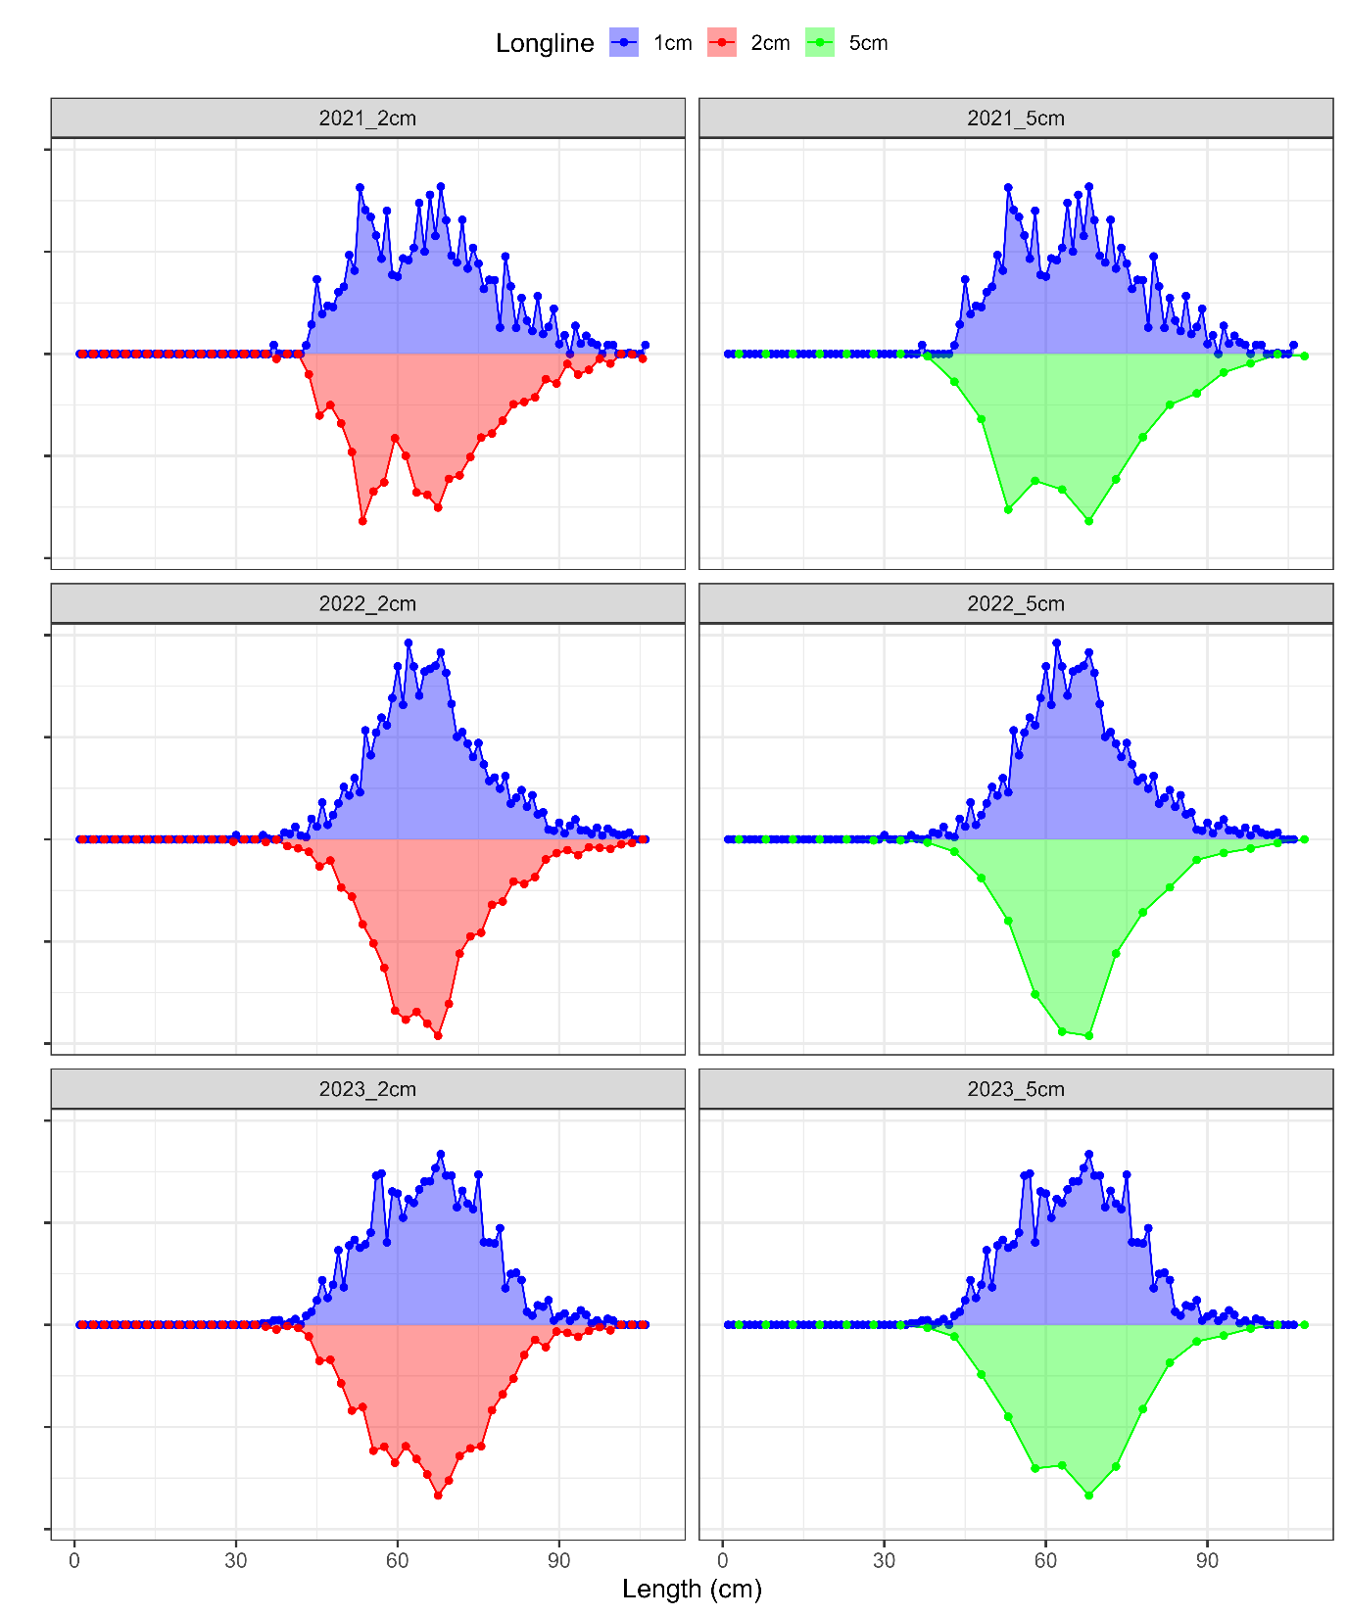
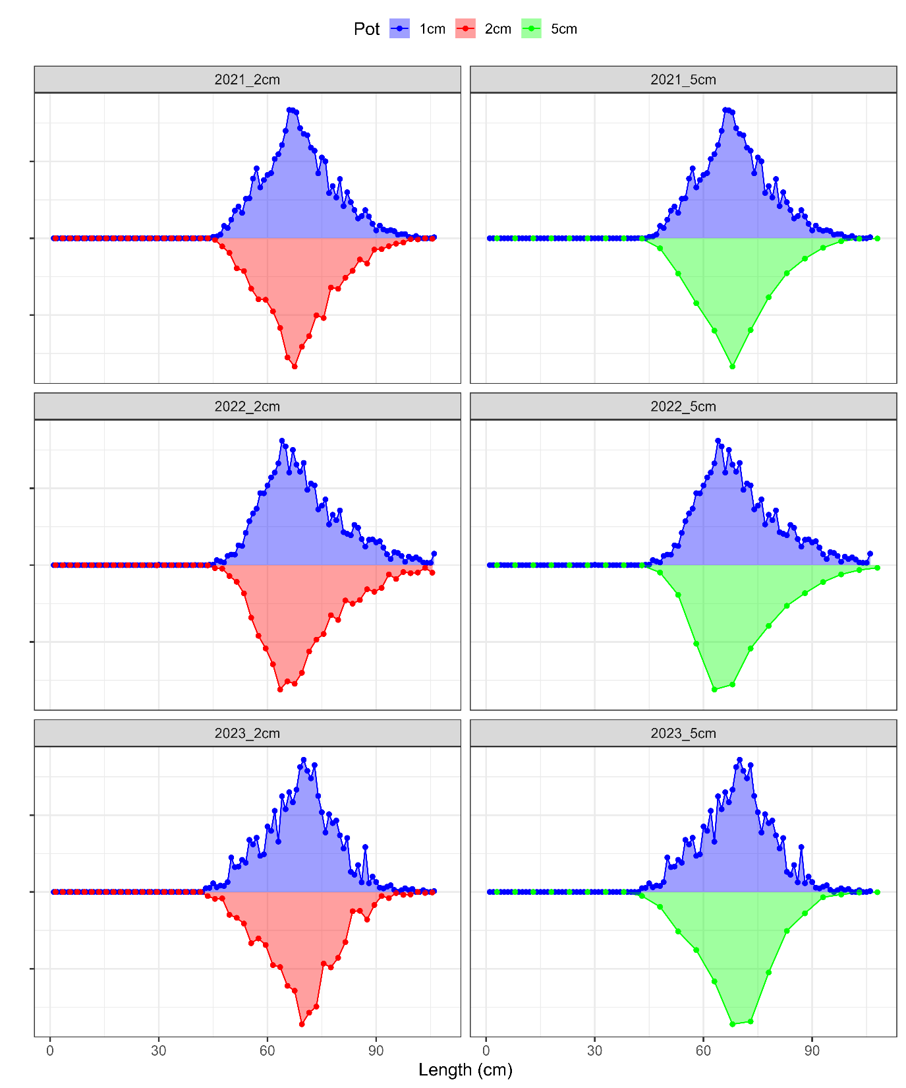
Length comp binning: fishery

Slide 34
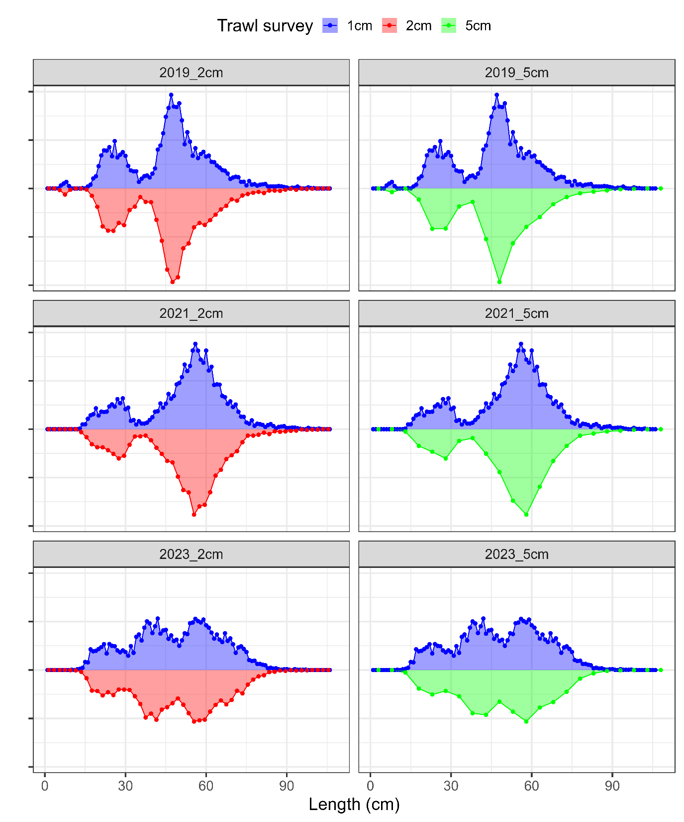
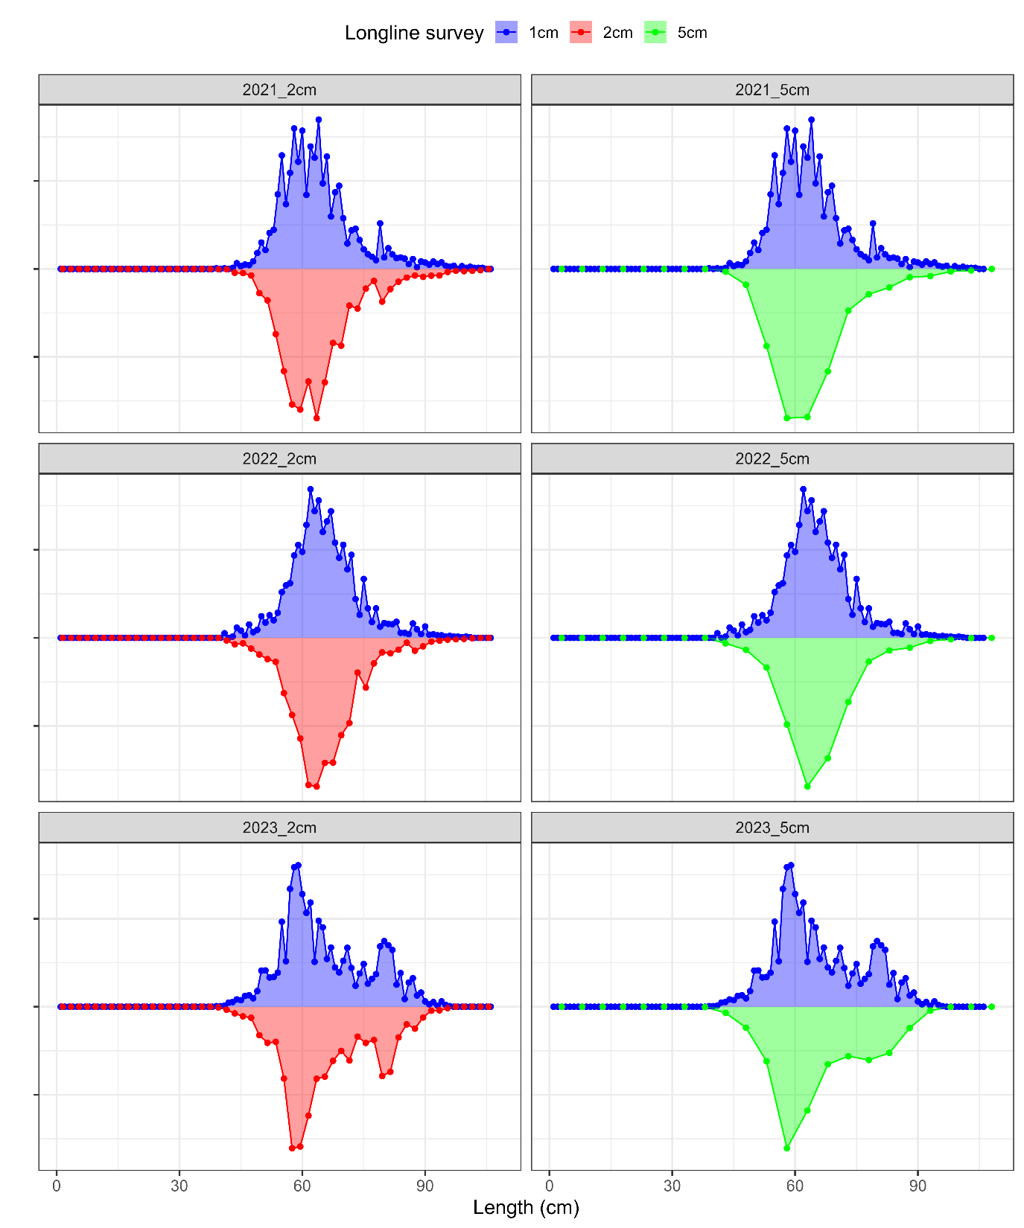
Length comp binning: survey

Slide 35
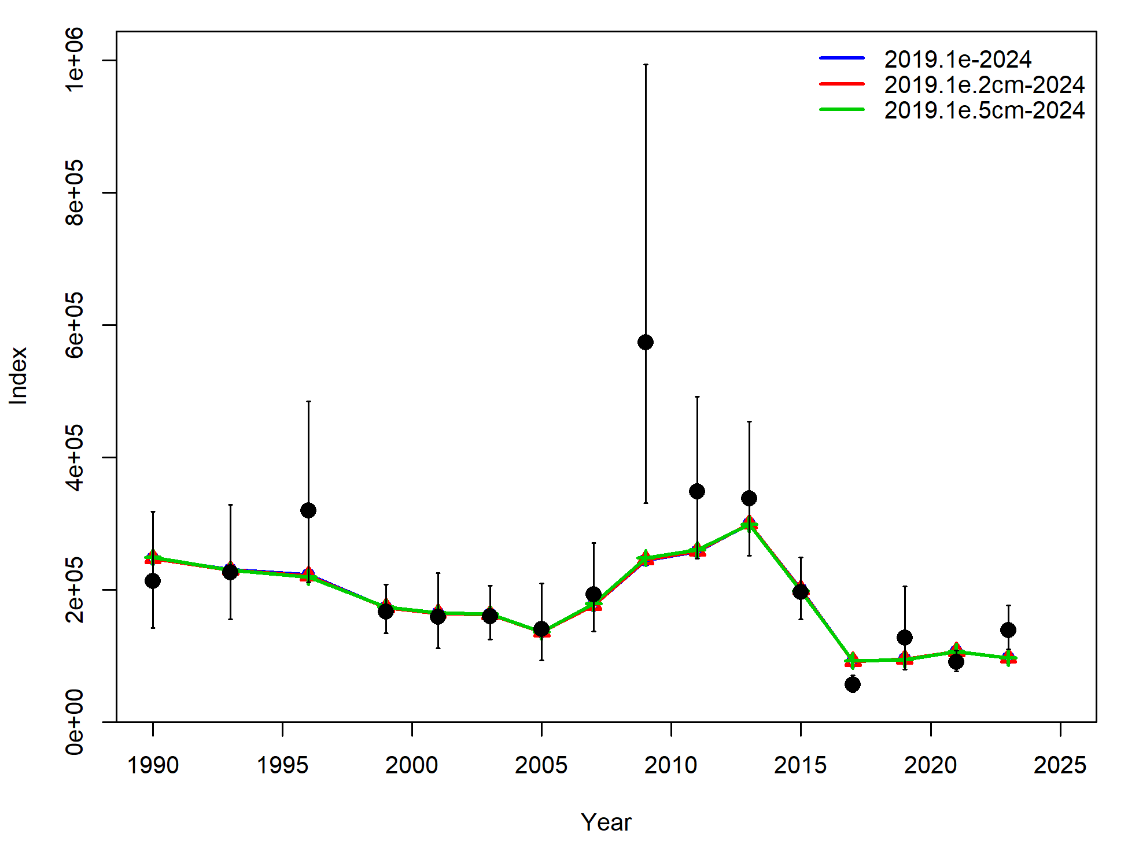
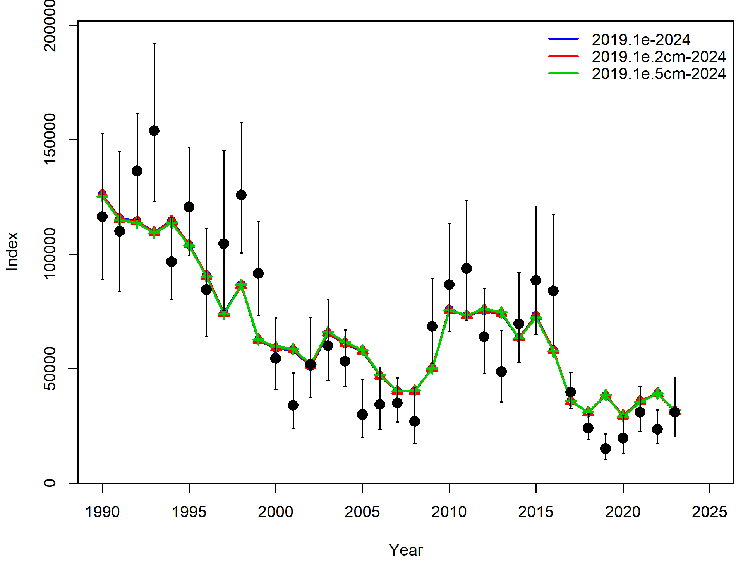
Length comp binning
Data fits:
Component | 2019.1e | 2019.1e.2cm | 2019.1e.5cm
TOTAL | 2715.80 | 2342.31 | 1974.01
Catch | 2.44E-12 | 1.98E-12 | 1.91E-12
Survey | 0.63 | 1.46 | 2.16
Length_comp | 1676.90 | 1507.59 | 1330.40
Age_comp | 1030.97 | 825.75 | 633.31
Recruitment | -3.03 | -2.74 | -1.62
InitEQ_Regime | 3.17 | 3.18 | 3.02
Parm_priors | 1.16 | 1.13 | 1.08
Parm_softbounds | 0.01 | 0.01 | 0.01
Parm_devs | 6.00 | 5.92 | 5.65

Slide 36
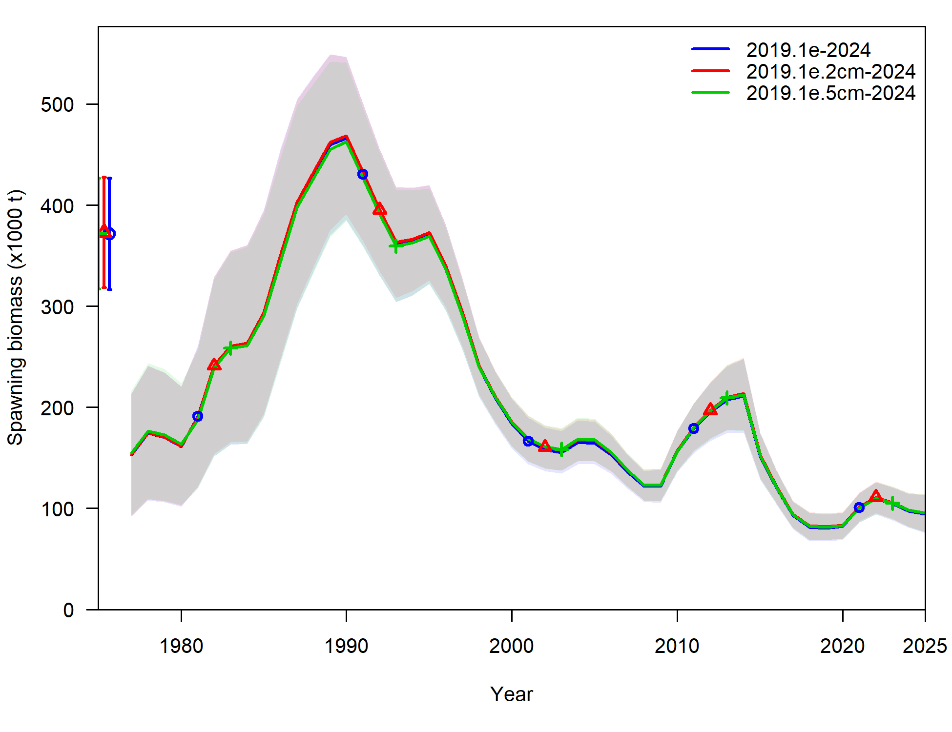
Length comp binning
SSB:

Slide 37
Length comp binning
Model robust to changes in length comp binning
Provides a more efficient model, reduces run time by 53%
To increase model efficiency Recommend new model 2019.1e.5cm
To increase model naming efficiency, Recommend new model 2019.1e.5cm be renamed as model 2024
While the model’s parameters/etc are the same as in the accepted 2019 model, significant differences exist in data inputs at this point

Slide 38
Recommended model vs base
New …

Slide 39
Summary of significant model changes
New …

Slide 40
November models
New data that will be available:
Updated catch, fishery length comps
2023 Trawl survey CAAL
2023 Fishery CAAL
Models to present in November

Slide 41
SSC/PT comments
Several SSC/PT comments were investigated

Slide 42
Maturity
Recent tagging studies have provided potential information to update maturity ogive in assessment
Currently assessment uses maturity as estimated from the sizeMat R package using data from Stark (2007)
In process of comparing new information from recent tagging studies to what’s used in assessment, discovered a transcription error: in SAFE L_{50%} = 57.3 cm, in model ctl file L_{50%} = 53.7 cm

Slide 43
Maturity
In process of comparing new information from recent tagging studies to what’s used in assessment, discovered a transcription error: in SAFE L_{50%} = 57.3 cm, in model ctl file L_{50%} = 53.7 cm

Slide 44
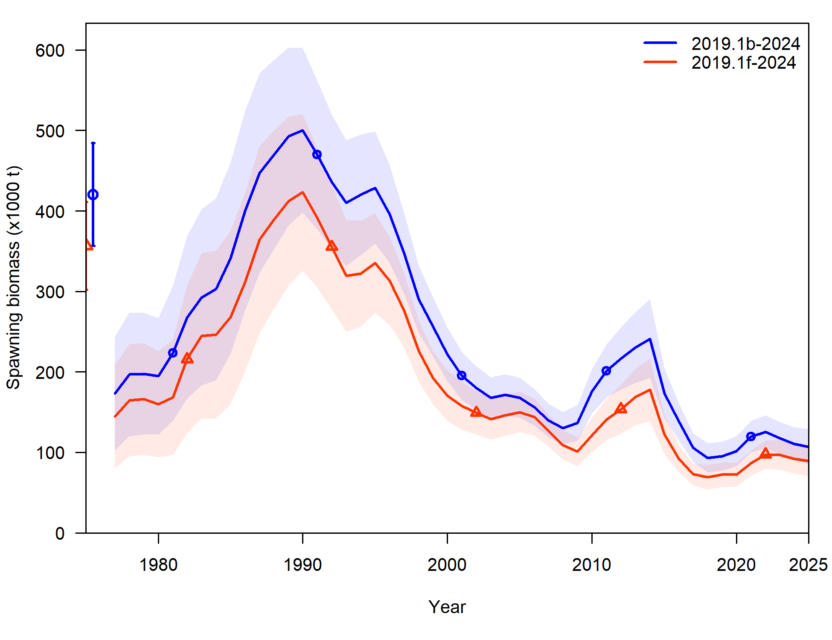
Maturity
Use model 2019.1e.5cm and correct transcription error, new model: 2019.1f

Slide 45
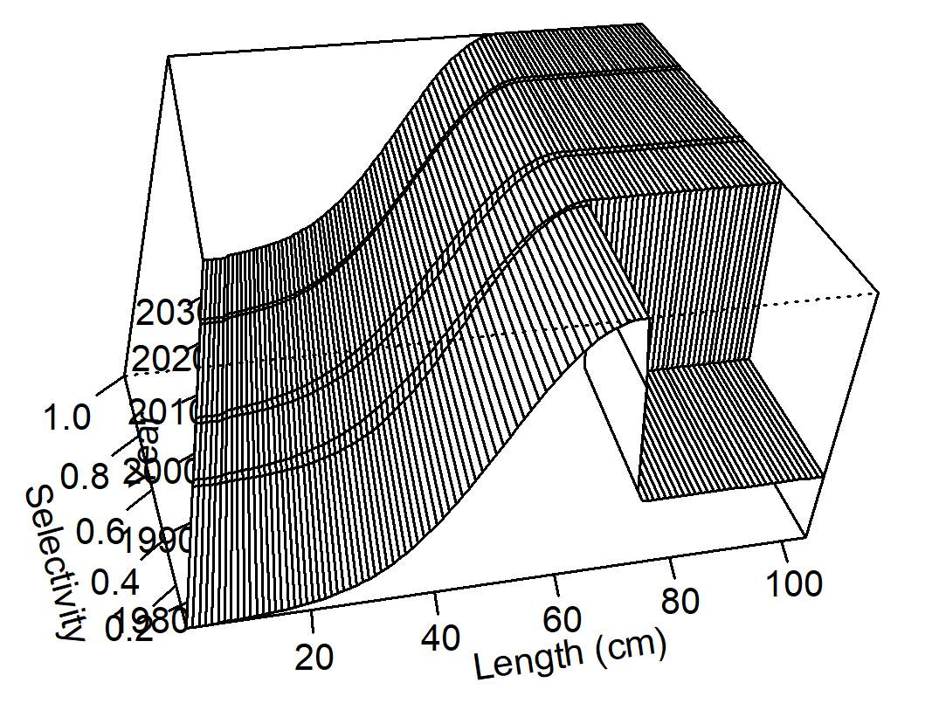
Trawl survey selectivity
In process of input data changes: descending width for trawl survey selectivity approaching 0 for <= 1996 block
2 years of survey index/length/CAAL data
Investigate time-invariant, asymptotic, trawl survey selectivity
Set parameter initial values (and whether estimated or not) to what is used in most recent time block
New model: 2024.0

Slide 46
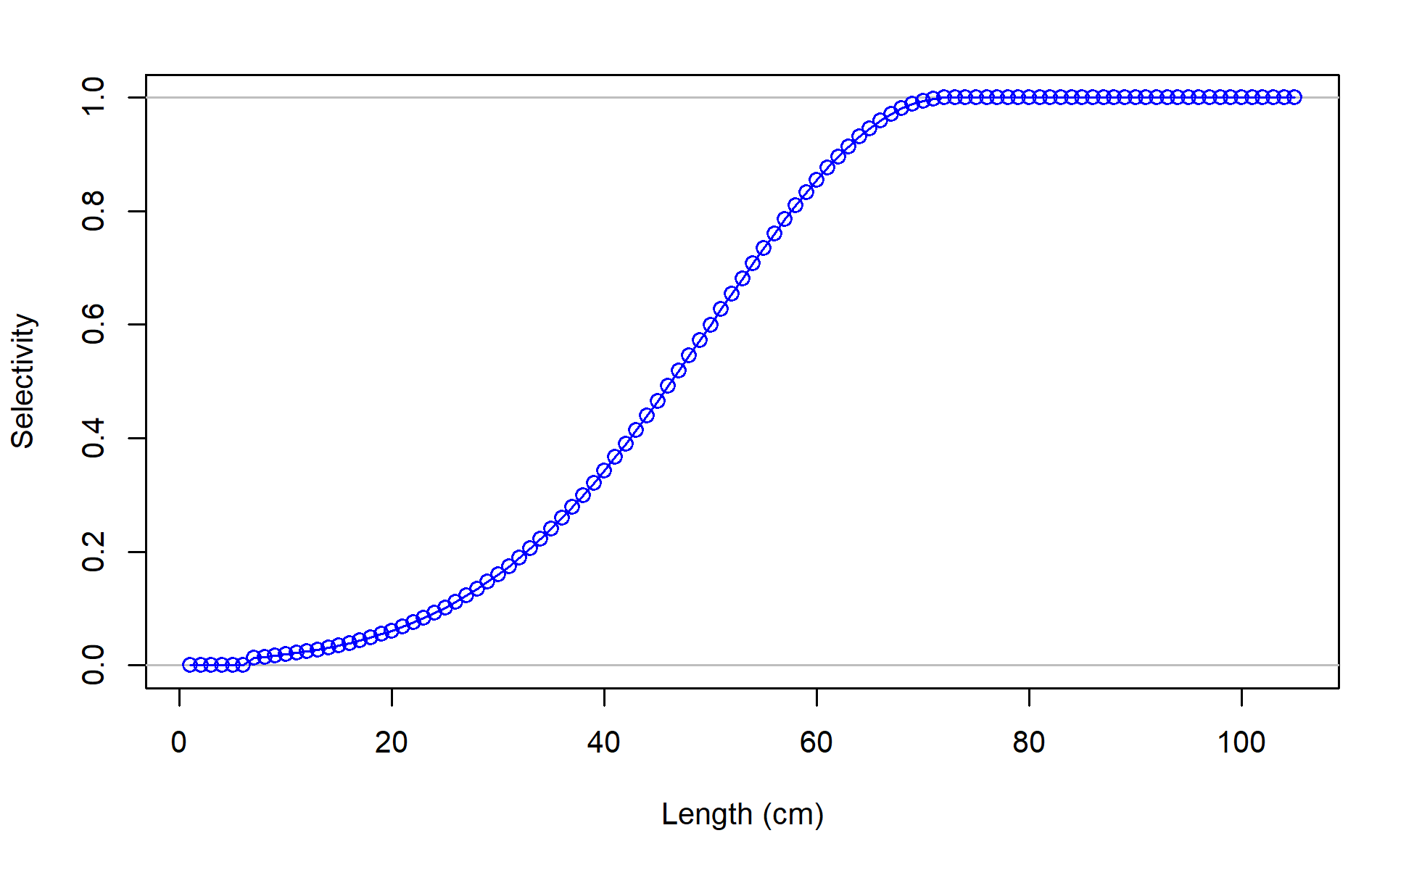
Trawl survey selectivity
New model: 2024.0
Component | 2019.1f | 2024.0
TOTAL | 2029.67 | 2041.08
Catch | 0.00 | 0.00
Survey | 5.11 | 10.13
Length_comp | 1349.22 | 1357.23
Age_comp | 649.13 | 648.78
Recruitment | 0.77 | -0.26
InitEQ_Regime | 2.84 | 2.84
Parm_priors | 17.03 | 16.82
Parm_softbounds | 0.02 | 0.01
Parm_devs | 5.55 | 5.53
 | 2019.1f | 2024.0
TOTAL | 2029.67 | 2041.08
# params | 193 | 184
AIC | 4445.34 | 4450.16
ΔAIC | 0 | 4.82

Slide 47
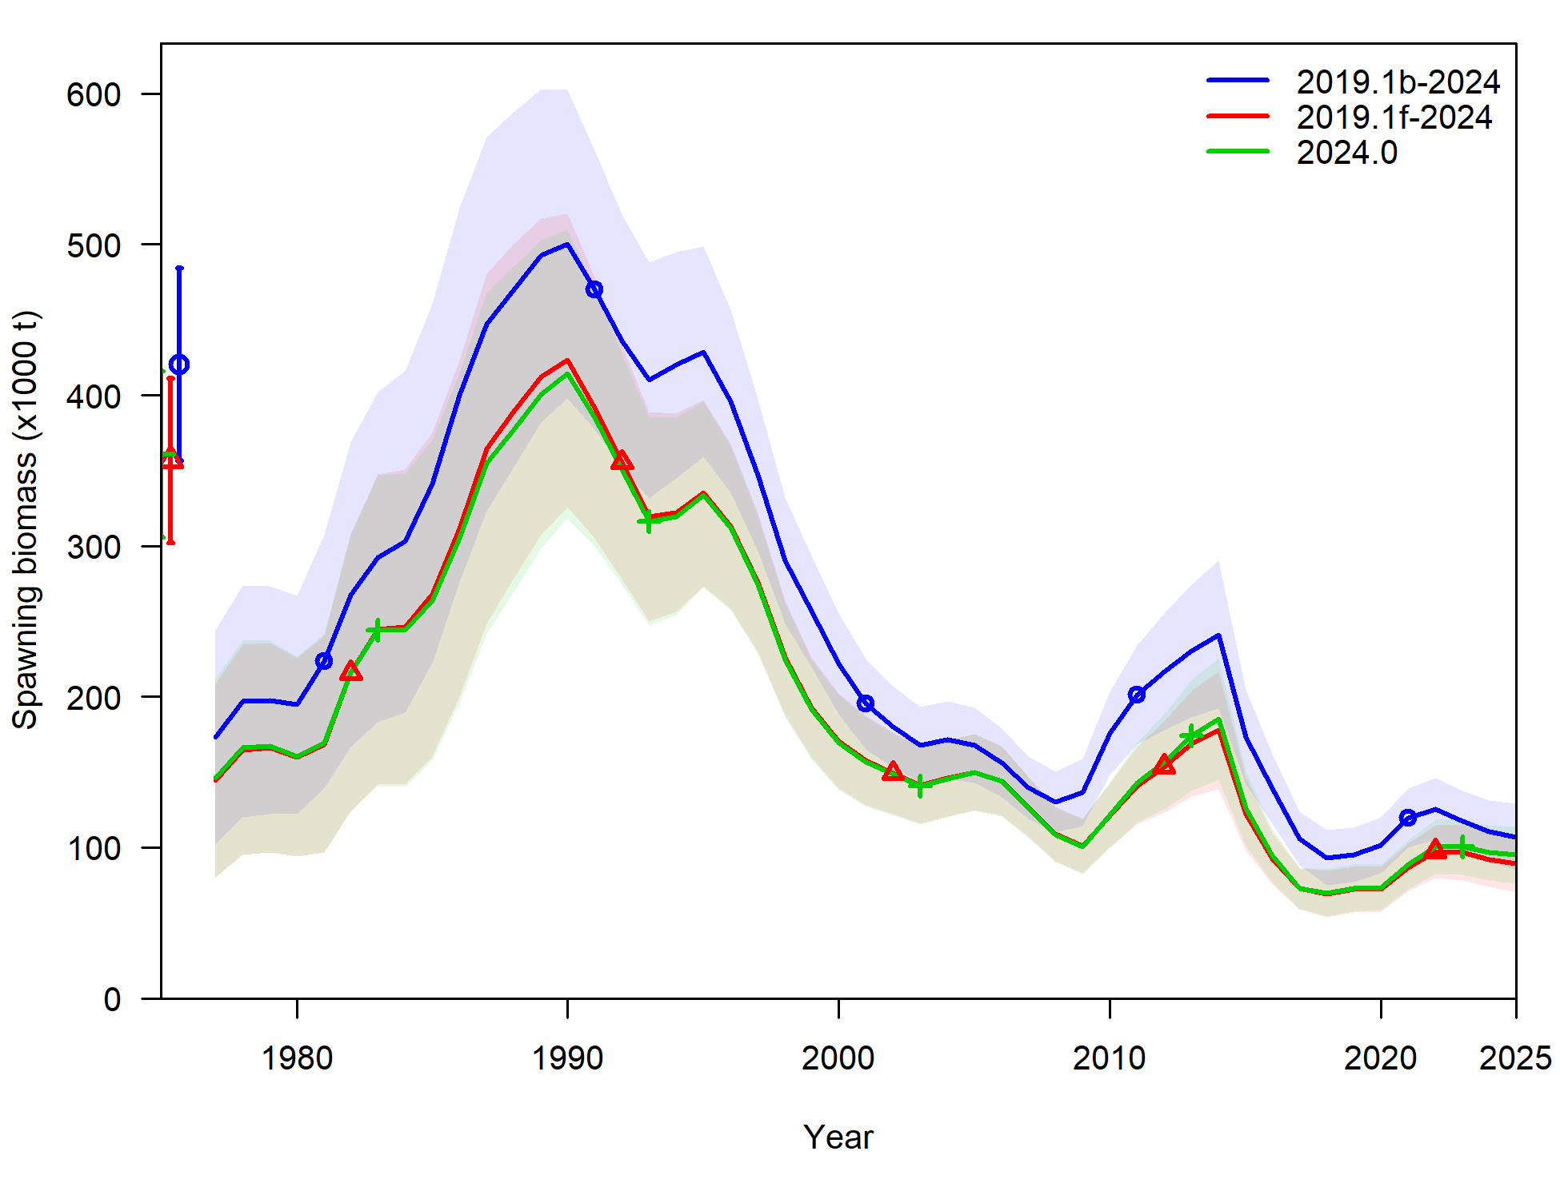
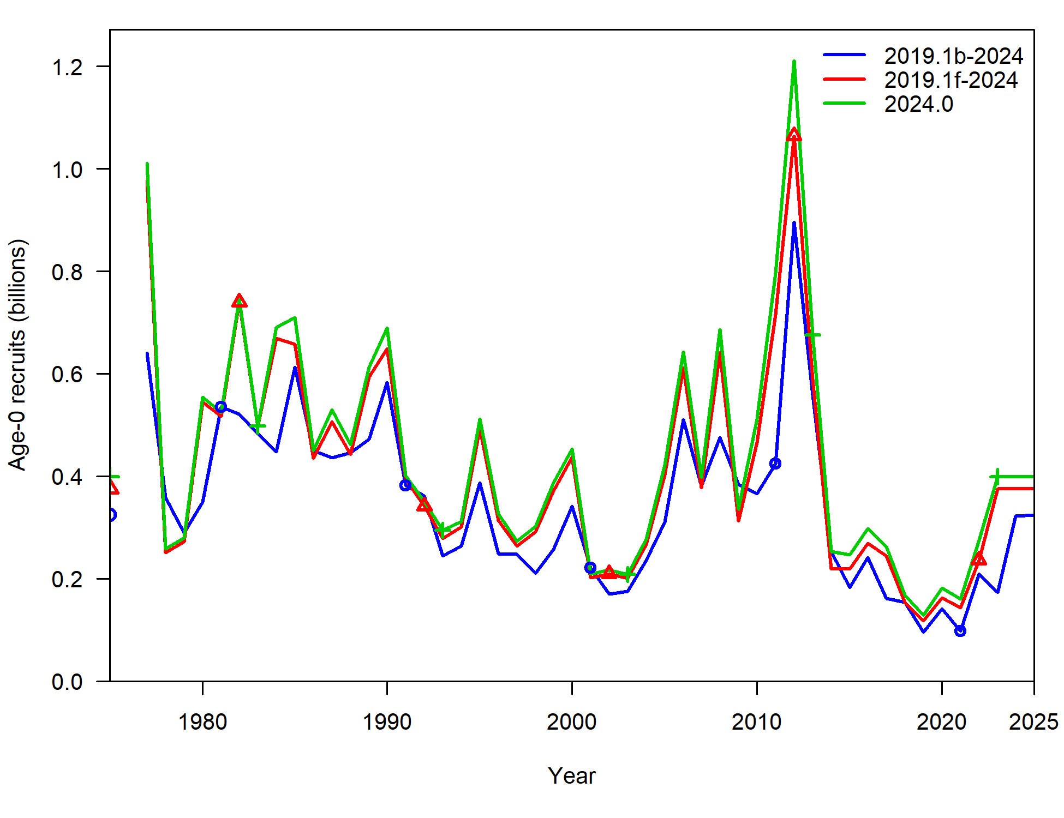
Trawl survey selectivity
New model: 2024.0

Slide 48
Summary of Recommendations
Recommended model 2024.0
Corrects a number of errors and better aligns with other cod assessments (2019.1c)
Updates ageing error (2019.1d)
Simplifies complexities in data inputs and data structure (2019.1e.5cm)
Corrects maturity transpose error (2019.1f)
Simplifies estimation of trawl survey selectivity (2024.0)

Slide 49
Apportionment investigation
Reminder: AFSC longline survey (LLS) used in assessment as additional pop’n index, but not used in apportionment
And, includes an environmental link, where in warmer temps at depth cod move deeper and are more available to the survey than in colder years
Including it in apportionment is a longstanding SSC request
Other, ‘tracked’, pop’n indices include IPHC FISS and ADF&G large mesh trawl survey

Slide 50
Apportionment investigation
Here, look at including LLS into REMA as an additional index to be used for apportionment
Step-wise approach:
First, look at AIC ‘preferred’ model when it comes to Process Error (PE) and index scaling (q) parameters
Next, with ‘preferred’ models investigate estimating additional observation error

Slide 51
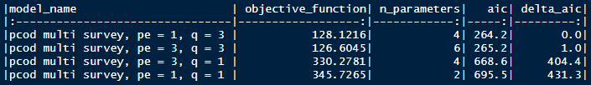
Apport inv: Step 1
4 cases: factorial design of global (1) x regional (3) PE & q parameters
AIC suggests that regional scaling parameters q are supported (and most influential)
Whether PE = 1 or 3, no real difference in model

Slide 52
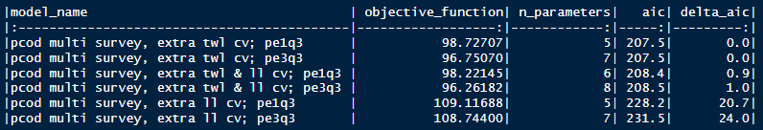
Apport inv: Step 2
Factorial design of 2 PE:q cases from step 1 x 3 uncertainty cases (trawl only, longline only, trawl & longline)
Results in 4 models that are essentially the same, in terms of AIC

Slide 53
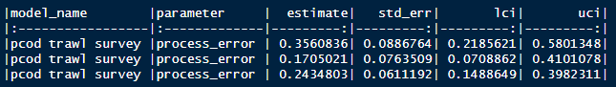
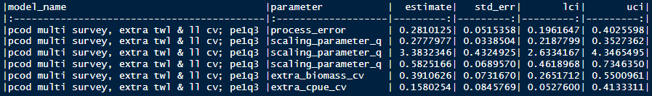
Apport inv: Comparisons
Compare between:
Base model: trawl survey only (pcod trawl survey)
Preferred model: both trawl and longline survey with 1 process error parameter, 3 scalar parameters, and additional uncertainty estimated for both surveys

Slide 54
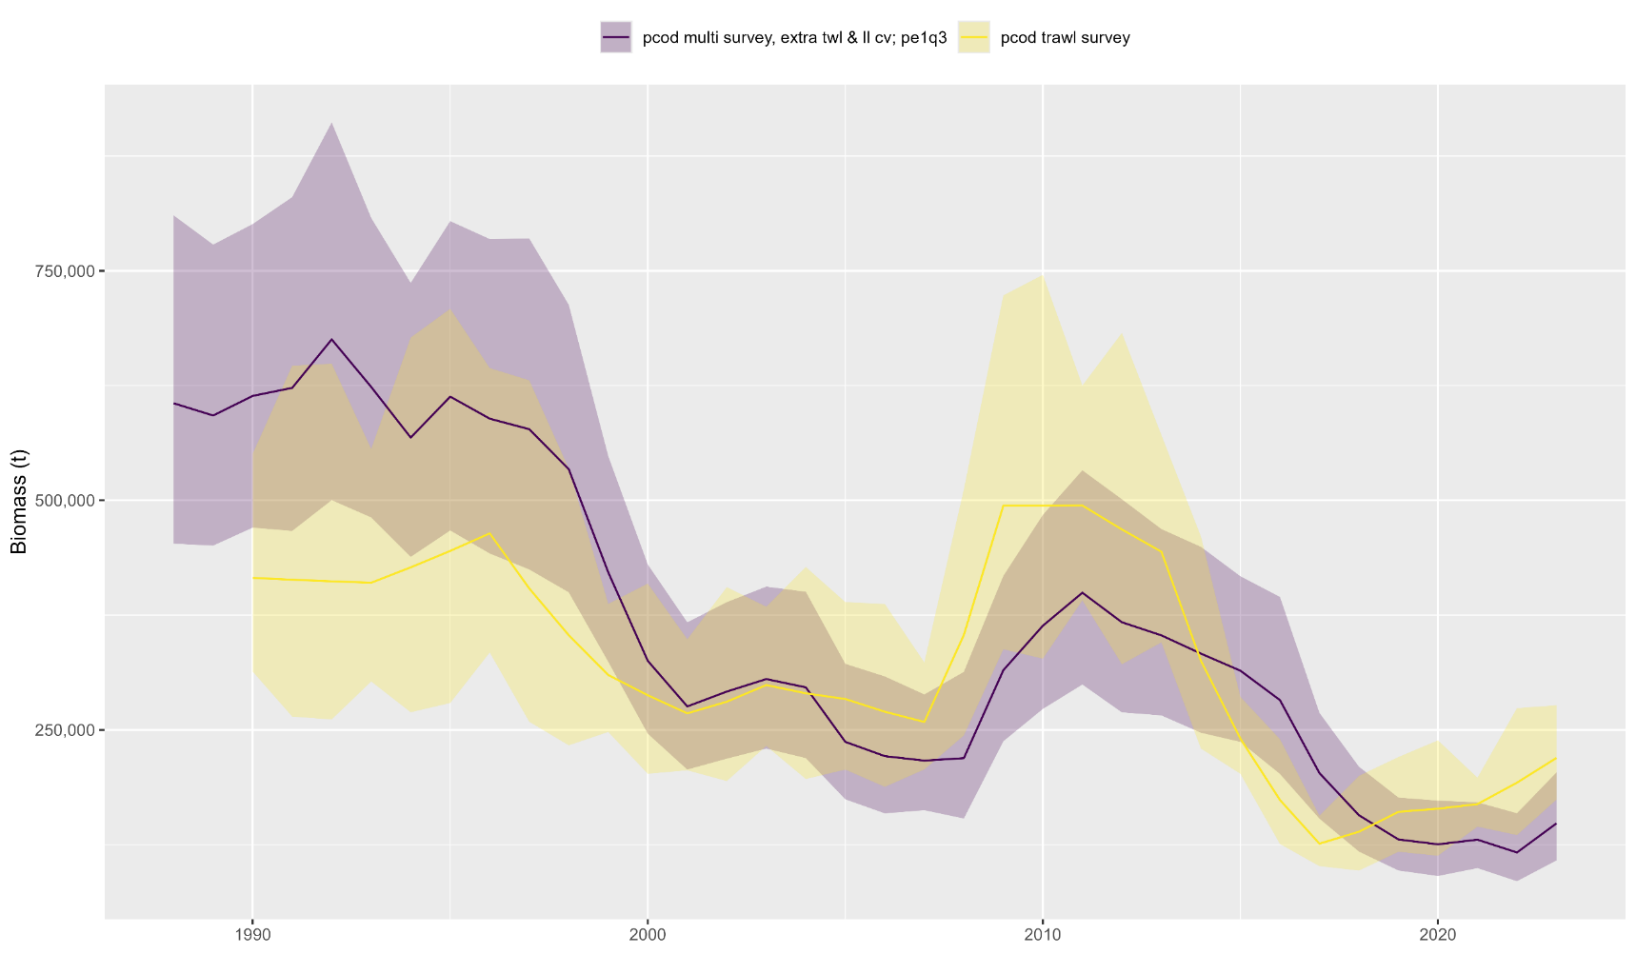
Apport inv: Comparisons
Estimated biomass:

Slide 55
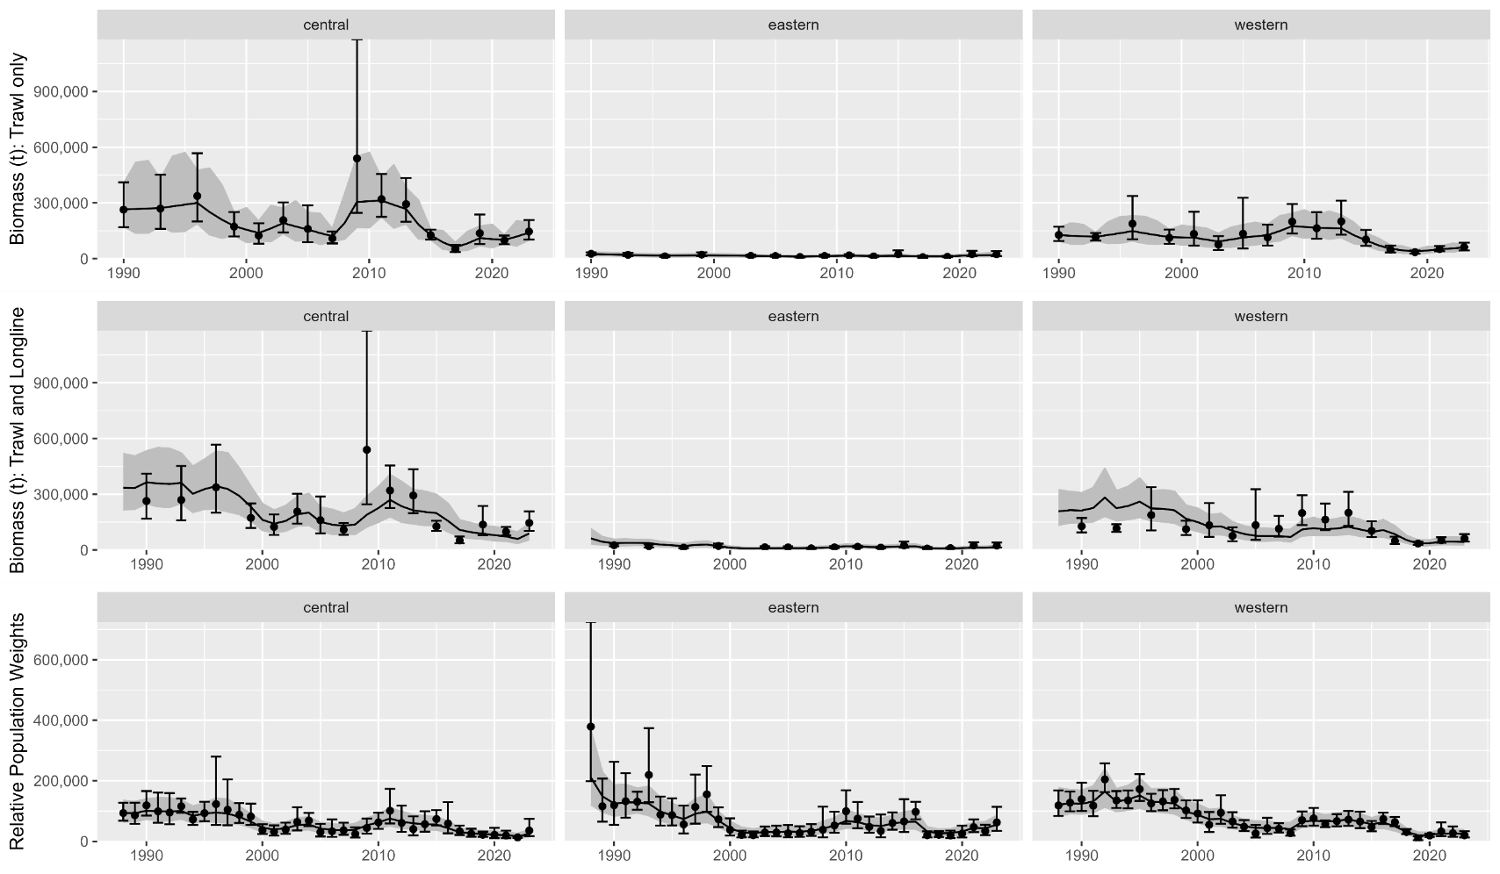
Apport inv: Comparisons
Data fits:

Slide 56
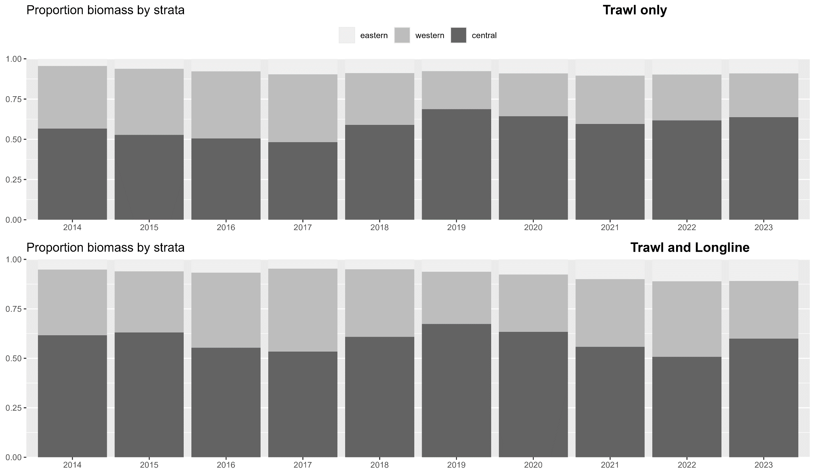
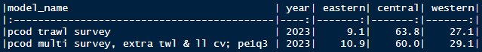
Apport inv: Comparisons
Apportionment:

Slide 57
Apport inv: Discussion
Recommendation: use rema with additional index with preferred parameterization
Makes apportionment consistent with data used in assessment
But, it will likely result in more variable apportionment compared to using only trawl survey
Next steps:
Working on environmental index, will be looking towards region indices to potentially be used in apportionment
Survey timing is slightly different in each region, whether/if this results in different environmental conditions by region remains to be seen
Currently rema not developed to include environmental index

Slide 58
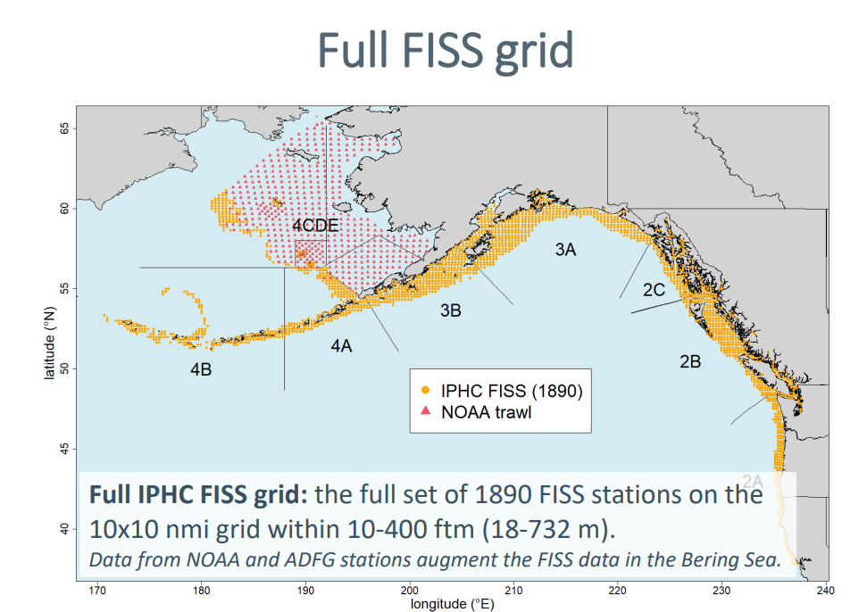
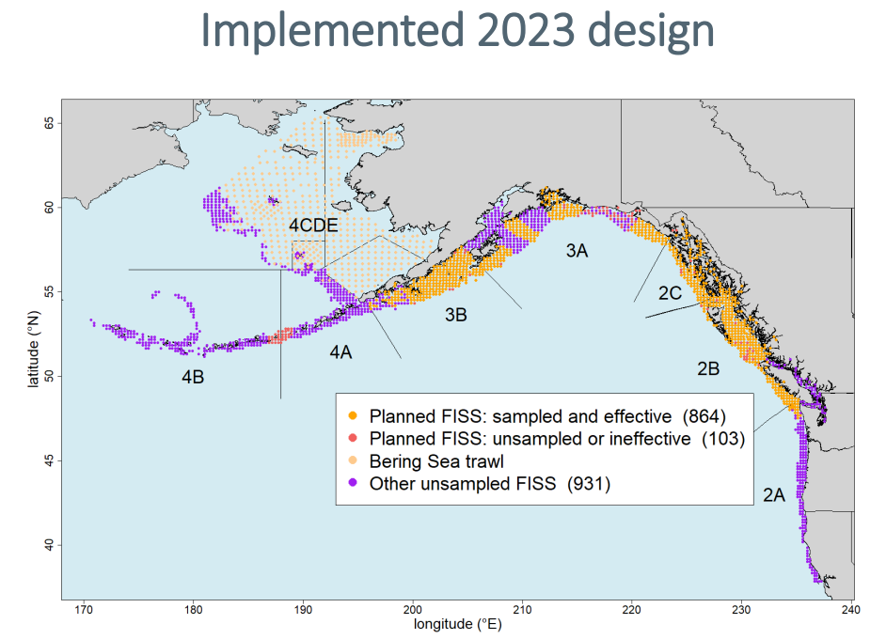
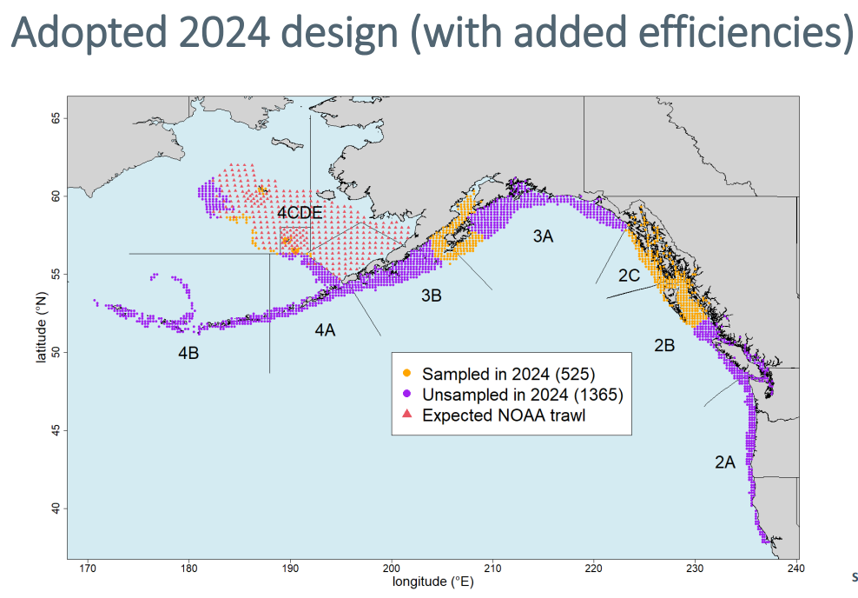
Apport inv: Discussion
Other indices: IPHC FISS
Has always been a promising additional index for apportionment, but, recent developments have made implementation questionable for Pacific cod
Recommend: not consider FISS as viable alternative index for Pacific cod until stations randomly subsampled or full FISS design is implemented

Slide 59
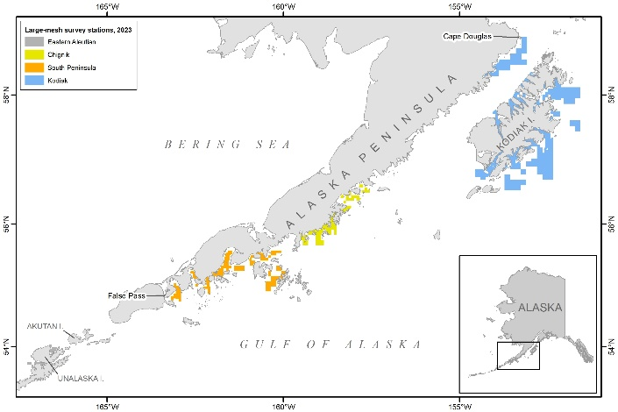
Apport inv: Discussion
Other indices: ADF&G large mesh survey
Rub here: only samples western and central gulf
But, if there is additional information about trend in these two subregions, could possibly use it in rema
However, rema currently not capable of including third index
Recommend: for now continue to track ADF&G survey in assessment, but since we have 2 indices in rema that have good spatial coverage, not spend time yet developing this as an additional index

Slide 60
Age comp inv
Fishery data:
Currently computed for males/females, then combined (and, excludes unsexed data)
But, length comps have never been computed this way, have always combined sex data prior to expansion
Computed with FSA package, rather than the observed ALK
Idea: randomly assigns lengths to ages with an ALK approach
But, can obtain ages that weren’t observed, particularly because
Requires: must define smallest lengths in each year as age-1
Propose:
Combine age/length data across sexes pre-expansion
Use year-specific ALK & remove age-1 assignment (stop using FSA package)
Use proposed length comp expansion
Why? You’ll see…

Slide 61
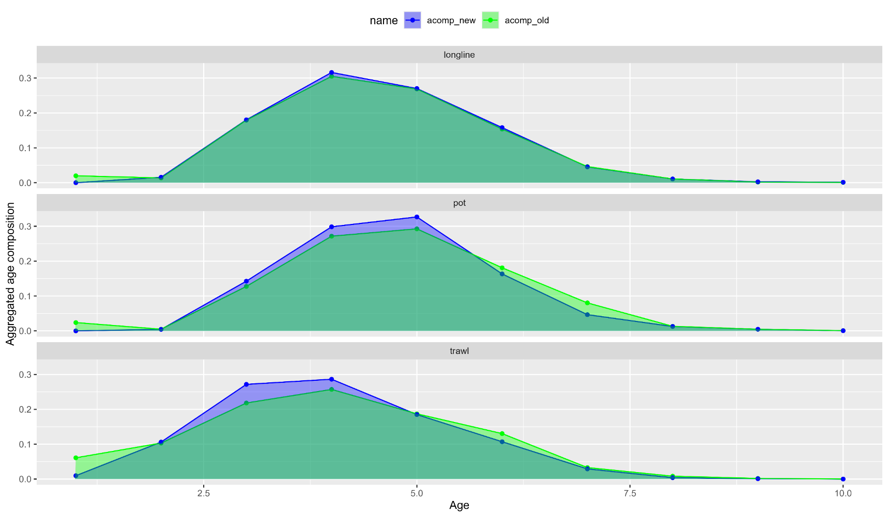
Age comp inv
Fishery data: aggregated plots

Slide 62
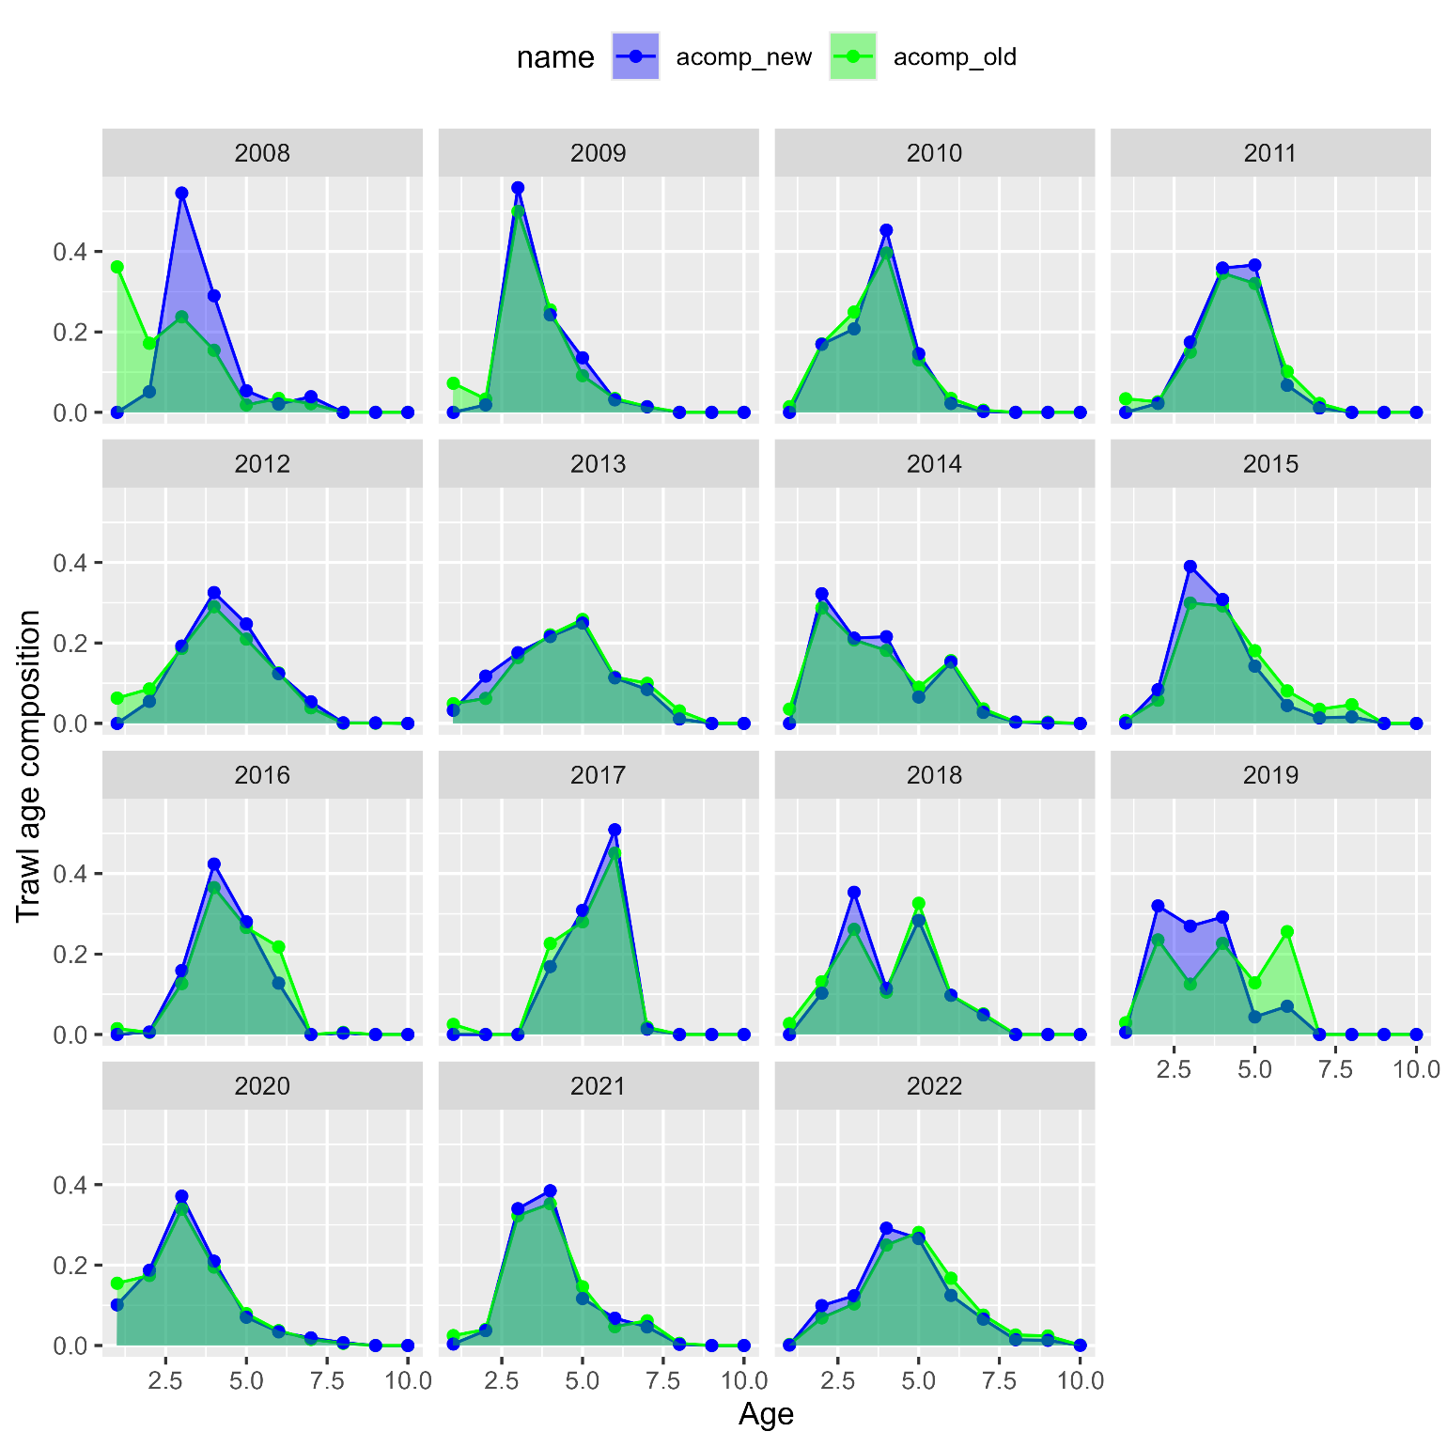
Age comp inv
Trawl fishery:

Slide 63
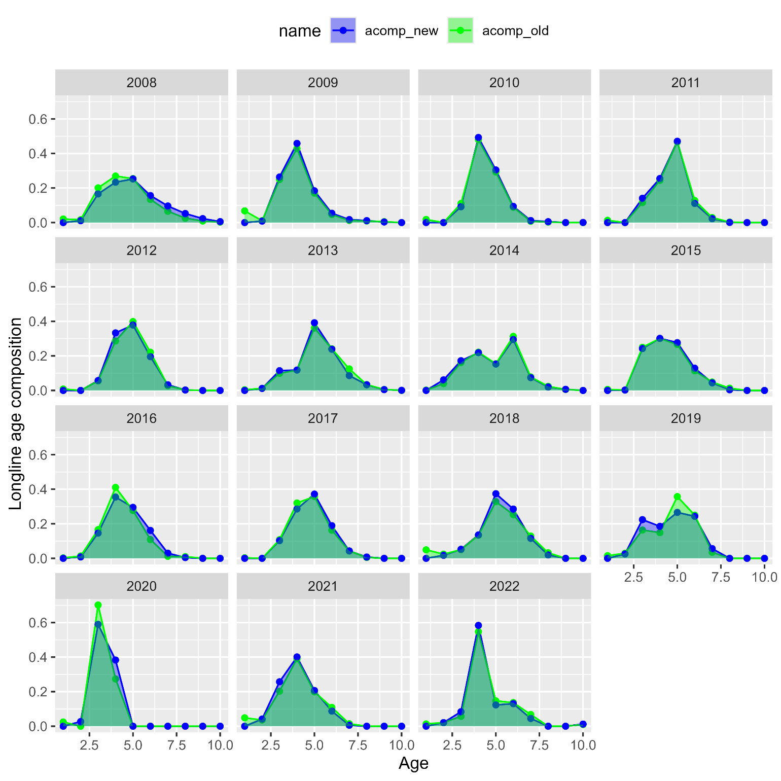
Age comp inv
Longline fishery:

Slide 64
Age comp inv
Pot fishery:

Slide 65


2019.1d
2019.1e

Slide 66



